Slide 1
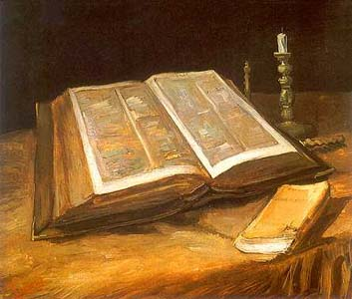
BIBLE - THINGS THAT ENSNARE US
HEBREWS 12:1-2

Slide 2
PRIDE - POWER
1 JN. 2:15-17
DAN. 4:33-37
DAN. 5:17-22
PSA. 10:4
PSA. 138:6
1 TIM. 6:3-6
JAMES 4:6-10

Slide 3
DESIRE FOR WORLDLY SUCCESS
COL. 3:23
MARK 10:42-45
JN. 5:44
JN. 12:42-43
JN. 13:12-17
PSA. 1:1-3

Slide 4
WORLDLY STANDARDS
JN. 1:11-12
PHIL. 3:5-11
1 COR. 4:11-13
DAN. 6:1-5
HEB. 11:24-25
TITUS 2:5
1 TIM. 5:14
PROV. 31:27-28

Slide 5
CONCLUSION
How are we running the race?
Are we being hindered?
We need to lay aside the weights and sin that hinder us!!!

