Slide 1
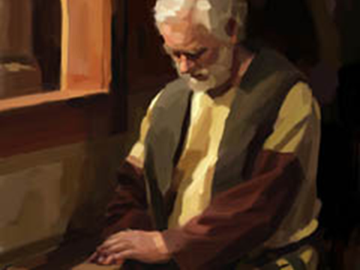
What Does the Bible Teach? Prayer
LUKE 11:1

Slide 2
- WHAT DOES THE BIBLE TEACH - PRAYER
WHAT IS PRAYER?
Psalm 61:1 - Crying out
1 Kings 8:28 – I.E. – Solomon
Matthew 7:7-11 – It is asking – seeking –knocking
1 Corinthians 14:15 – A way to address God which requires concentration
Luke 18:1-7 – Being persistent

Slide 3
- WHAT DOES THE BIBLE TEACH - PRAYER
WHAT MAKES PRAYER UNACCEPTABLE?
Psalm 66:18 - Iniquity
Proverbs 15:8, 29 – Being far from God
Isaiah 1:15 – Insincerity
Proverbs 28:9 – Turn away our ears
James 4:7-8 – Refusal to submit

Slide 4
- WHAT DOES THE BIBLE TEACH - PRAYER
WHAT MAKES PRAYER UNACCEPTABLE?
Substituting prayer for obedience
Matthew 7:21
Hebrews 5:8-9

Slide 5
- WHAT DOES THE BIBLE TEACH - PRAYER
WHAT MAKES PRAYER UNACCEPTABLE?
Selfishness
James 4:3

Slide 6
- WHAT DOES THE BIBLE TEACH - PRAYER
WHAT MAKES PRAYER UNACCEPTABLE?
Improper attitude
Matthew 6:14-15
Matthew 5:23-24

Slide 7
- WHAT DOES THE BIBLE TEACH - PRAYER
WHAT MAKES PRAYER UNACCEPTABLE?
Vain Repetitions
Matthew 6:5-7
Matthew 23:14
Luke 18:10-12

Slide 8
- WHAT DOES THE BIBLE TEACH - PRAYER
WHAT MAKES PRAYER ACCEPTABLE?
Godly Life
James 5:16
1 Peter 3:12

Slide 9
- WHAT DOES THE BIBLE TEACH - PRAYER
WHAT MAKES PRAYER ACCEPTABLE?
Godly Attitude
Matthew 6:9
James 1:5-7
Hebrews 4:16
Luke 18:13-14

Slide 10
- WHAT DOES THE BIBLE TEACH - PRAYER
WHAT MAKES PRAYER ACCEPTABLE?
Proper Authority
Ephesians 5:20

Slide 11
- WHAT DOES THE BIBLE TEACH - PRAYER
WHAT MAKES PRAYER ACCEPTABLE?
According to God’s will
Luke 22:42
Matthew 8:1-3

Slide 12
- WHAT DOES THE BIBLE TEACH - PRAYER
CONCLUSION -
The privilege of prayer belongs to God’s children.
How is your prayer life?
Are your prayers acceptable to him?
Do you pray as you should?
Make your life right with the Lord today!

