Slide 1
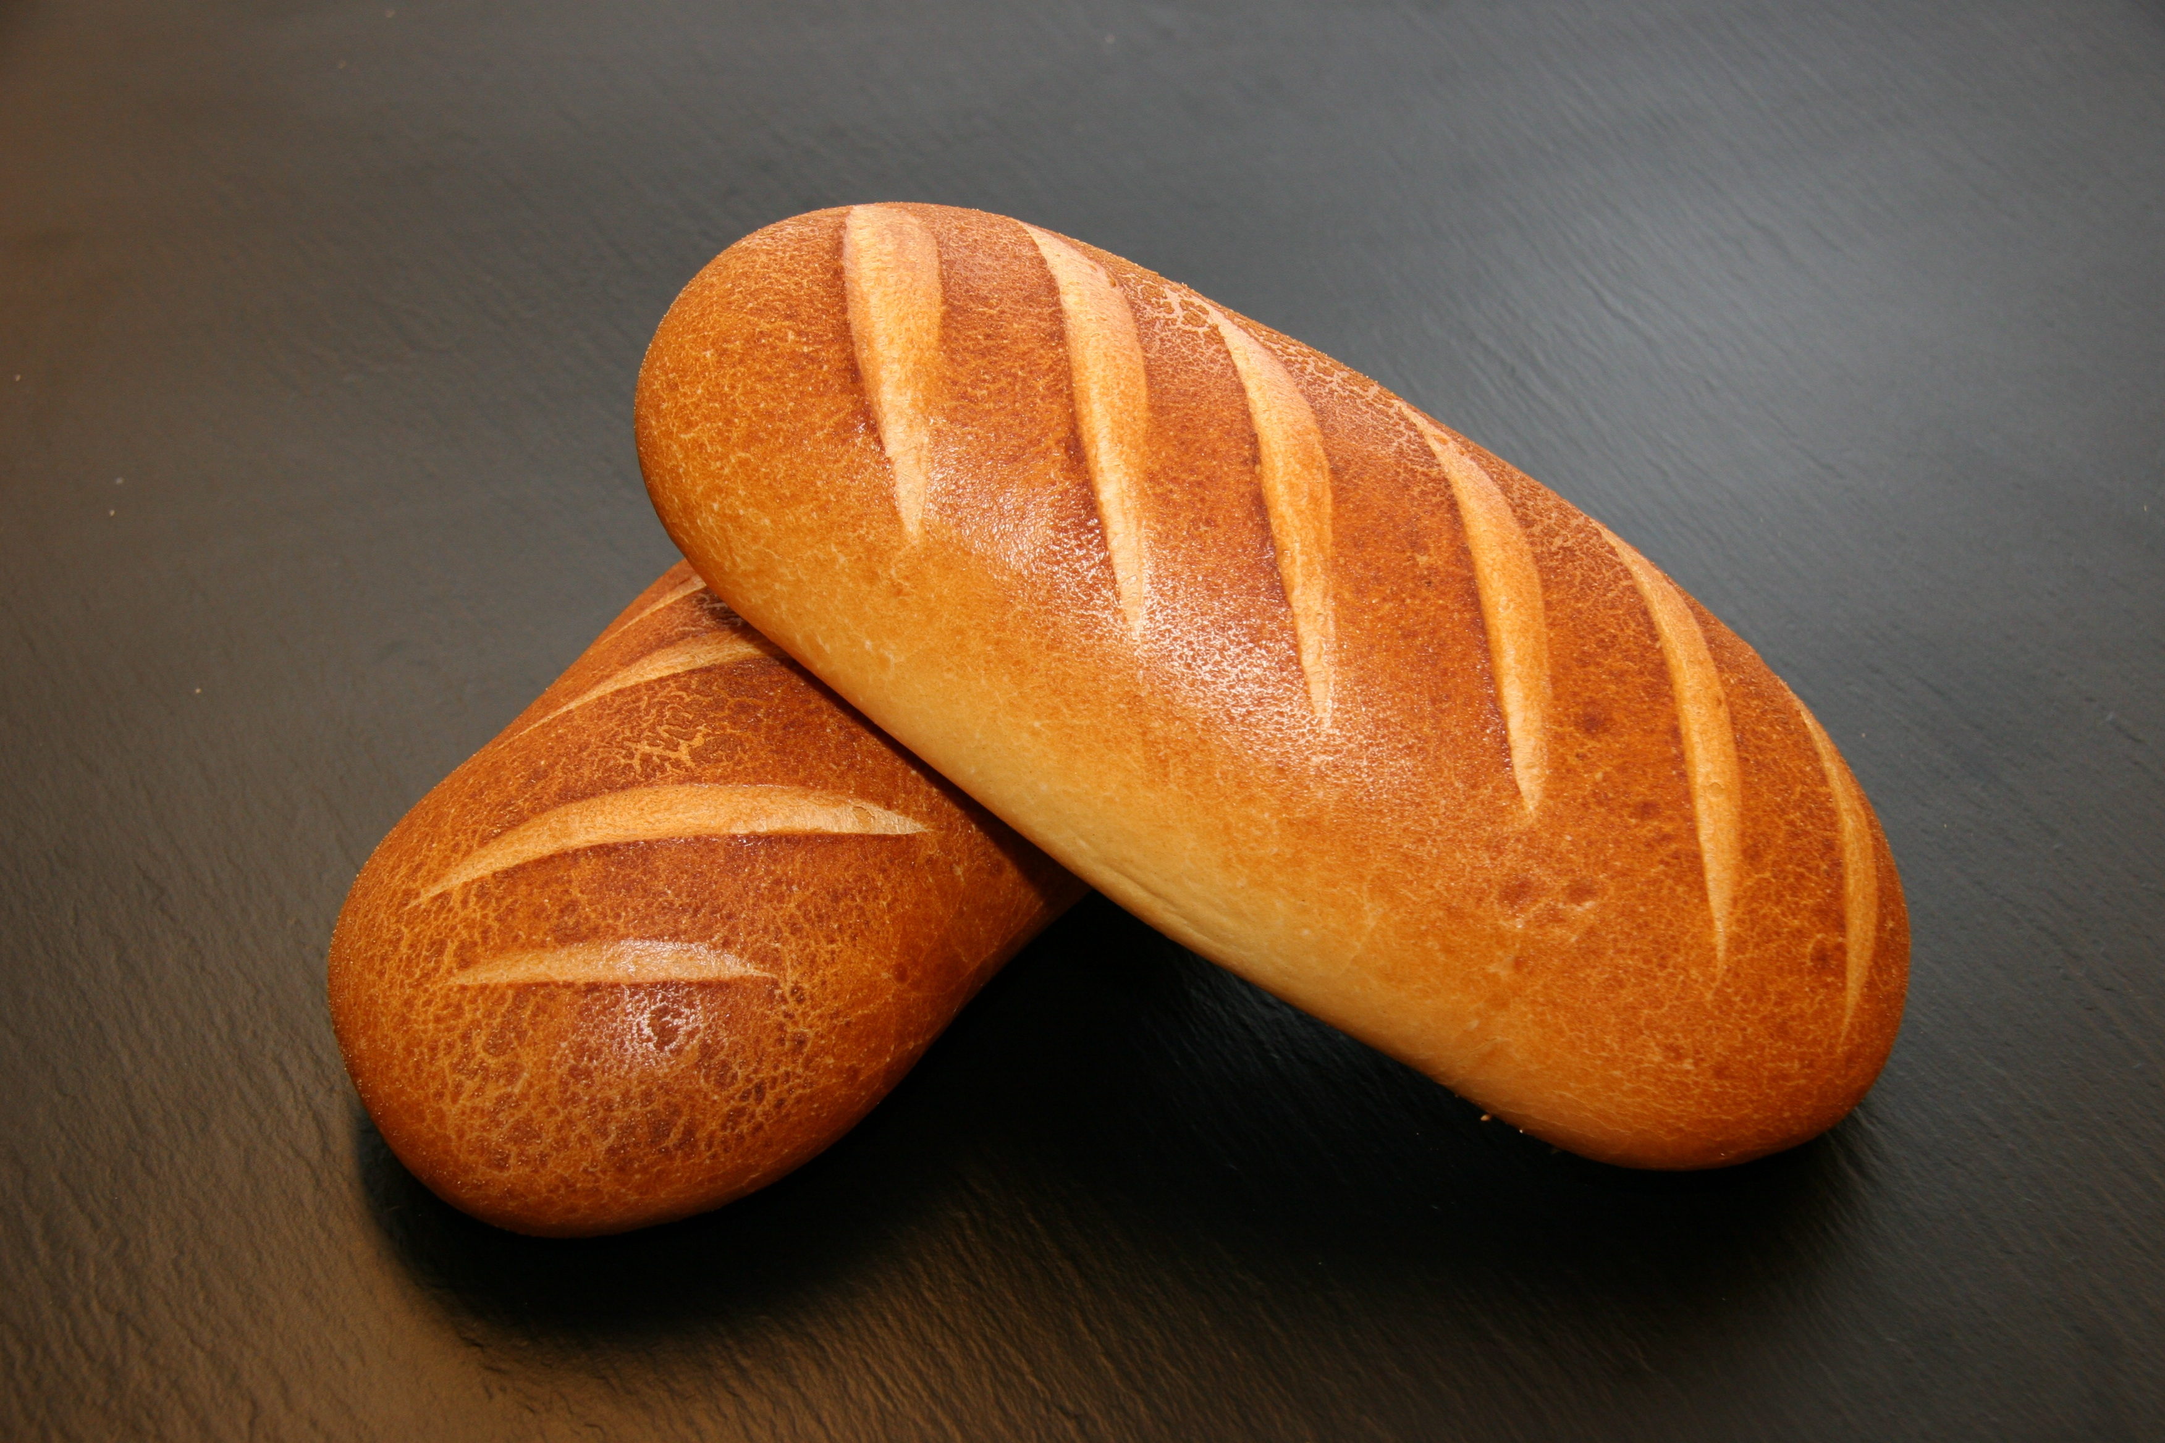
“I Am the bread of life”
John 6:35

Slide 2
Context of John Chapter 6
Jesus fed 5000 with 5 loaves and 2 fish. (vs. 1-14)
Not only to be a “sign” to be believed (vs. 14, but to teach His disciples their roles. (Mark 6:36-41; Matthew 14:16; cf., Matthew 25:14-30; 1 Cor. 4:6)
“Set before…” (Mark 6:41; Acts 17:3; 20:32; 2 Timothy 2:2)
The multitudes try to “take Him by force to make Him King”. (vs. 15)
Notes:
Remember, Jesus knows what He’s going to do (John 6:6) but He has some things to teach first. He said to them:
What is the mindset of the disciples?
“Shall we go and spend two hundred denarii on bread and give them something to eat?” (vs. 37)
Jesus’ response: No!
“How many loaves do you have? Go look!” (vs. 38)
Jesus expected His disciples to first consider what they could do and what they had available. (cf., 2 Corinthians 8:12)
They didn’t know but they went and “found out” and said, “five loaves and two fish.” (vs. 38)
Was 5 loaves and 2 fish sufficient to feed the multitude? No, but Jesus expected them to start with that.
The role of the apostles wasn’t over:
Jesus directed the apostles to serve to the multitude that which He distributed to them. “He blessed them and broke them, and kept giving them to the disciples to set before the people.” (6:41; Luke 9:16; cf., Matthew 14:19)
Their role was one of service. (Matthew 20:26-28; John 13:14-17; Luke 22:26-28)
This word is normally used in a spiritual sense!
“To set before (one) in teaching.” (Thayer) (2 Timothy 2:2, “*entrust (commit; ASV; NKJV) these to faithful men”; Matthew 13:24, 31; Acts 17:3 & 20:32)
Jesus’ great commission to the apostles: (Matthew 28:18-20; Mark 16:15-16) in which He gave to the disciples that which they needed to “set before the people” in their preaching and teaching.
“By force” - “to seize, carry off by force.” (Acts 23:10; cf., John 10:28-29)
His omniscience not only included their general intentions but their specific ones including what kind of “King” they wanted Him to be. (6:26; “…you seek Me… because you ate of the loaves and were filled.”)

Slide 3
Context of John Chapter 6
Jesus (1) sends His disciples across the Sea, (2) disperses the crowd and then (3) goes up to the mountain to pray. (Matthew 14:23)
Jesus then comes to His disciples “walking on the sea… and they were frightened”. (vs. 19)

Slide 4
Context of John Chapter 6
Jesus said, “It is I; do not be afraid”.
In the Greek, what Jesus said, was “I am, do not be afraid.”
Note in John 8:58 that the Jews understood this to be a claim to deity as God identified Himself to Moses in Exodus 3:14, “I AM WHO I AM”.
Notes:
I AM - Hebrew, “to exist” or “to be”. The self existent One.
OT:1961
So Ex 3:14 is more than a simple statement of identity: "I am that I am"; it is a declaration of divine control of all things (cf. Hos 1:9).
(from Vine's Expository Dictionary of Biblical Words, Copyright © 1985, Thomas Nelson Publishers.)
Jesus was indeed in control of all things.

Slide 5
Context of John Chapter 6
“The next day…” (vs. 22)
“The crowd” follows after Jesus and His disciples (vs. 23-25) and asks “when did You get here?”
Jesus knowing their hearts declares, “Truly, truly, I say to you, you seek Me, not because you saw signs, but because you ate of the loaves and were filled. Do not work for the food which perishes, but (work) for the food which endures to eternal life, which the Son of Man will give to you, for on Him the Father, God, has set His seal.” (vs. 26-27)
Notes:
Emphasize, “not” - “but”
They had worked so hard to follow Jesus just to be fed physically… Jesus didn’t say “don’t work that hard” but to channel that same effort into the spiritual food He came to provide.
Work for that which the Father will give. Study, listen, apply, walk by faith, obey, deny, sacrifice, persist, endure.
“Do not work for the food which perishes, but (work) for the food which endures to eternal life, which the Son of Man will give to you, for on Him the Father, God, has set His seal.” (vs. 27) [Not this… but this…]
What had they just done (how far had they just traveled) to seek their next meal? (cf., Matthew 12:42)
Apply this same level of diligence (work) in seeking the spiritual food that provides eternal life. (John 4:13-14; cf., Ezekiel 3:3; Jeremiah 15:16)
Work is involved in obtaining “the food which endures to eternal life.” (Philippians 2:12; Ephesians 6:13; 1 Corinthians 15:10; Colossians 1:29
Job 23:12 - do we treasure the word of God more than our necessary food?

Slide 6
Context of John Chapter 6
Picking up on Jesus mentioning “work”, they ask, “what shall we do, that we may work the works of God?” (vs. 28)
Jesus’ response begins with having faith in who He truly is. “…believe in Him whom He has sent.” (vs. 29)
Jesus later said, “unless you believe that I am (He), you will die in your sins.” (John 8:24; cf., 13:19)
Faith is a “work of God”.
Notes:
Much of the rest of this discourse is about Jesus’ relationship with the Father.

Slide 7
Context of John Chapter 6
The Jews have the audacity to ask of Jesus; “What then do You do for a sign, so that we may see, and believe You? What work do You perform?” (vs. 30; 1:50; 2:11; 3:2; 6:14; 20:30-31)
They had something in mind: daily meals like manna in the wilderness. (vs. 31, note vs. 34, “always give us this bread”; cf., 4:15)
Jesus contrasts the fleshly with the spiritual referring to the “true bread out of heaven.” (vs. 32)
Notes:
Jewish documents from the 2nd century reveal the expectation that the Messiah would provide manna on a daily basis.
Jesus points out it wasn’t Moses who would give “true” bread nor was he responsible for the manna.

Slide 8
Context of John Chapter 6
“Our fathers ate the manna in the wilderness…” (vs. 31) “…always give us this bread…” (vs. 34)
The “fathers” weren’t satisfied with manna. (Numbers 11:4-6; 21:4-5)...
God let them be hungry to learn to depend on Him. (Deuteronomy 8:3)
They were to learn, “man does not live by bread alone, but man lives by everything that proceeds out of the mouth of the Lord.” (Deuteronomy 8:3)
Notes:
Eccl 7:10
Do not say, "Why is it that the former days were better than these?“ For it is not from wisdom that you ask about this.

Slide 9
“I AM The bread of life” (vs. 35)
The first of Jesus’ 7 “I AM” statements.
“I AM the bread of life” (6:35)
“I AM the light of the world” (8:12)
“I AM the door of the sheep” (10:7)
“I AM the good shepherd” (10:11)
“I AM the resurrection and the life” (11:25)
“I AM the way, the truth, and the life” (14:6)
“I AM the true vine” (15:1)

Slide 10
“I AM The bread of life” (vs. 35)
After their immediate request, Jesus makes it clear that He isn’t speaking of literal bread… “I AM the bread of life”.
“Bread out of heaven…” (vs. 33, 41, 42, 50, 51, 58)
Jesus’ invitation is to “come to Me” and “believe in Me”. (Matthew 11:28; John 5:40; 6:44, 65)

Slide 11
“I AM The bread of life” (vs. 35)
What is to be done with the “bread of life”?
It is to be consumed… (“Eat” and “drink”)
Literal or figurative?
God asks His servants to consume His words. (Ezekiel 3:1-4; Jeremiah 15:15-16; Psalms 119:103; Psalms 19:10)
Notes:
Ezek 3:1-7
Then He said to me, "Son of man, eat what you find; eat this scroll, and go, speak to the house of Israel." 2 So I opened my mouth, and He fed me this scroll. 3 He said to me, "Son of man, feed your stomach and fill your body with this scroll which I am giving you." Then I ate it, and it was sweet as honey in my mouth.
4 Then He said to me, "Son of man, go to the house of Israel and speak with My words to them. 5 "For you are not being sent to a people of unintelligible speech or difficult language, but to the house of Israel, 6 nor to many peoples of unintelligible speech or difficult language, whose words you cannot understand. But I have sent you to them who should listen to you; 7 yet the house of Israel will not be willing to listen to you, since they are not willing to listen to Me. Surely the whole house of Israel is stubborn and obstinate.
Jeremiah 15:15-16
You who know, O Lord, Remember me, take notice of me, And take vengeance for me on my persecutors. Do not, in view of Your patience, take me away; Know that for Your sake I endure reproach.
16 Your words were found and I ate them, And Your words became for me a joy and the delight of my heart; For I have been called by Your name, O Lord God of hosts.
Ps 119:103
How sweet are Your words to my taste! Yes, sweeter than honey to my mouth!

Slide 12
“I AM The bread of life” (vs. 35)
To be consumed are the words of the bread of life:
Drawn by the Father (vs. 44)… How? “‘They shall all be taught of God’. Everyone who has heard and learned from the Father comes to Me.” (vs. 45)
We “eat” and “drink” of Jesus when we “abide” in Him and He in us. (Fellowship)
“Difficult” words? Why? (1 Cor. 2:14-3:3; John 12:37-42)
“The words I have spoken to you are spirit and are life.” (vs. 63)
To whom shall we go for the “words of eternal life”? (vs. 66)

Slide 13
What are we to do with the bread of life
Work diligently for it, both in our knowledge and understanding (2 Timothy 2:15) and in our application of it. (Matthew 7:24-27)
Consume it frequently, consistently and persistently. (1 Timothy 4:6; 1 Peter 2:2)
Maintain our spiritual appetite.
Urgently obey it!

