Slide 1
Lessons learned from Jonah
Luke 11:29-32

Slide 2
WHO IS JONAH?
A prophet of God in Israel during the reign of Jeroboam II who spoke of the restoration of Israel’s border… a period of time of great patriotism and national pride. (2 Kings 14:25)
Later, Amos and Hosea spoke of the impending judgment of God on Israel by the Assyrians. (Amos 5:27; Hosea 9:3)
Not an allegory… Cited by Jesus (Matthew 12:38-42)
Notes:
JONAH
[JOE nuh] (a dove) - the prophet who was first swallowed by a great fish before he obeyed God's command to preach repentance to the Assyrian city of Nineveh. Jonah was not always a reluctant spokesman for the Lord. He is apparently the same prophet who predicted the remarkable expansion of Israel's territory during the reign of Jeroboam II (ruled about 793 B.C. - 753 B.C.; 2 Kings 14:25). This passage indicates that Jonah, the son of Amittai, was from Gath Hepher, a town in Zebulun in the northern kingdom of Israel.
While Jonah is described as a servant of the Lord in 2 Kings 14:25, he is a sad and somewhat tragic figure in the book bearing his name. It is a mark of the integrity and reliability of the Bible that a prophet like Jonah is described in such a candid manner. The natural tendency of human writers would be to obscure and hide such a character. But the Spirit of God presents valiant heroes along with petty people to illustrate truth, no matter how weak and unpleasant these characters may have been. We know nothing of Jonah after he returned to Israel from his preaching venture in Nineveh.
(from Nelson's Illustrated Bible Dictionary, Copyright © 1986, Thomas Nelson Publishers)
Israel was at its lowest extremity, i.e early in Joash's reign, when Jehovah (probably by Jonah) promised deliverance from Syria, which was actually given first under Joash, in answer to JEHOAHAZ' (which see) prayer, then completely under Jeroboam II. Thus, Jonah was among the earliest of the prophets who wrote, and close upon Elisha who died in Joash's reign, having just before death foretold Syria's defeat thrice (2 Kings 13:14-21). Hosea and Amos prophesied in the latter part of the 41 years' reign of Jeroboam II. The events recorded in the book of Jonah were probably late in his life.
(from Fausset's Bible Dictionary, Electronic Database Copyright © 1998, 2003, 2006 by Biblesoft, Inc. All rights reserved.)
The strangeness is an argument for the inspiration of the sacred canon; but the solution is, Israel is tacitly reproved. A pagan city repents at a strange prophet's first preaching, whereas Israel, God's elect, repented not, though admonished by their own prophets at all seasons. An anticipatory dawn of the "light to lighten the Gentiles," Jonah was a parable in himself: a prophet of God, yet a runaway from God; drowned, yet alive; a preacher of repentance, yet one that repines at repentance resulting from his preaching. God's pity and patience form a wonderful contrast to man's self will and hard hearted pettiness. His name, meaning "dove," symbolizes mourning love, his feeling toward his people, either given prophetically or assumed by him as a watchword of his feeling.
(from Fausset's Bible Dictionary, Electronic Database Copyright © 1998, 2003, 2006 by Biblesoft, Inc. All rights reserved.)
Amos (Amos 5:27) had foretold that Israel for apostasy should be carried "captive beyond Damascus," i.e. beyond that enemy from which Jeroboam II had just delivered them, according to the prophecy of Jonah, and that they should be "afflicted from the entering in of Hamath unto the river of the wilderness" (the southern bound of Moab, then forming Israel's boundary), i.e. the very bounds restored by Jeroboam II, for "the river of the
Arabah " or "wilderness" flowed into the S. end of "the sea of the plain" or Dead Sea (2 Kings 14:25; Amos 6:14). Hosea too (Hos 9:3) had foretold their eating unclean things in Assyria.
(from Fausset's Bible Dictionary, Electronic Database Copyright © 1998, 2003, 2006 by Biblesoft, Inc. All rights reserved.)
JEROBOAM
Jeroboam II, the 14 th king of Israel, who reigned for 41 years (793 B.C. - 753 B.C.). Jeroboam was the son and successor of Joash (or Jehoash); he was the grandson of Jehoahaz and the great-grandson of Jehu (2 Kings 13:1,13; 1 Chron 5:17). The Bible declares that Jeroboam "did evil in the sight of the Lord" (2 Kings 14:24).
(from Nelson's Illustrated Bible Dictionary, Copyright © 1986, Thomas Nelson Publishers)
2 Kings 14:25
[The word of the LORD ... which he spake] Some have found the prophecy of Jonah here alluded to, or a portion of it, in Isa 15; 16 (see 2 Kings 16:13); but without sufficient grounds.
(from Barnes' Notes, Electronic Database Copyright © 1997, 2003, 2005, 2006 by Biblesoft, Inc. All rights reserved.)

Slide 3
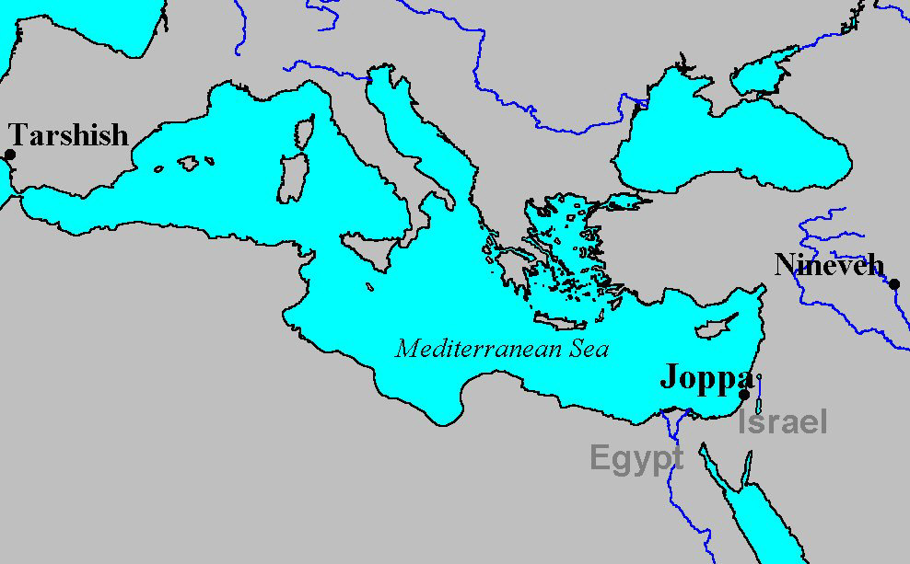

Slide 4
OUTLINE OF JONAH
Chapter 1: Running from God
Chapter 2: Running back to God (Luke 15:15-18)
Chapter 3: Running with God (Philippians 2:13)
Chapter 4: Running ahead of God (James 2:1-5)
Notes:
Running from God
God commands Jonah to go to Nineveh and cry against it
Jonah attempts to flee to Tarshish by going to Joppa and paying passage on a ship
The Lord hurls a great wind & storm
Every man cried to his god for salvation, however, no record that Jonah cried to his God
Jonah admits that he is responsible for the storm and asks to be thrown overboard
Jonah thrown into sea, storm stops
Men feared the Lord, offered sacrifice, made vows
God appoints a great fish to swallow Jonah
Jonah lives inside the fish three days and three nights
Running back to God - hitting rock bottom
Jonah prays to God from inside the fish
Jonah credits God for hearing his distress while in the sea and for answering his call of distress
Jonah acknowledges God’s ownership of the breakers and the billows
Jonah describes his desperation as he was encompassed by water, weeds wrapped around his head – to the point of death
Jonah credits God with his salvation, sparing his life from drowning by sending a great fish
Jonah points out the folly of those who regard vain idols
Jonah offers thanksgiving, promising sacrifice and fulfillment of vows, noting “Salvation is from the Lord.”
God commands the fish to vomit Jonah onto dry land
Running with God
God commands Jonah again to go to Nineveh and cry against it, proclaiming what He would tell him
Jonah obeyed God, arose and went to Nineveh
Jonah preached to a third of the city, “Yet 40 days and Nineveh will be overthrown.”
Jonah convinced the people of Nineveh, they believed in God, fasted and put on sackcloth (signs of repentance)
Word spread throughout the city, even to the king, who also believed, repented, and proclaimed a city-wide fast to avoid the judgment of God and certain destruction
God witnessed their deeds, their repentance, and changed His mind regarding their destruction
Running ahead of God
Jonah is displeased with God’s sparing of His wrath against Nineveh, and becomes angry, questioning God’s decision
Jonah prays to God, telling Him “I told you so,” that if the people of Nineveh were preached to, that they might repent and be spared destruction, because of the compassionate nature of God
Jonah pleads to die, as he doesn’t want to be held responsible for the salvation of a gentile nation, an enemy of Israel.
Jonah makes a shelter and sits to watch if God might still destroy the city (to follow his advice)
God appoints a plant for shelter, then a worm to attack the plant, then a scorching east wind
Jonah is angry once again and pleads to die
God points out Jonah’s hypocrisy in feeling compassion for a plant and none for over 120,000 ignorant people and their animals

Slide 5
We Can Not Escape From Our Responsibilities Before God.
God has revealed His will to man. (Jonah 1:2; Hebrews 1:1-2; Matthew 17:5)
God’s instructions are understandable. (Genesis 3:1-6; Ephesians 3:3-5; 5:17)
There’s never a time nor a place… (Jonah 1:3; Jeremiah 23:23-24; Psalms 139; Hebrews 4:13)
All men are accountable. (Acts 17:30; 1 Corinthians 6:9-11)
There are no excuses. (Luke 14:16ff; Acts 17:30; 1 Peter 1:14)

Slide 6
God Hates Sin & Holds All Accountable
God is never indifferent to sin. (Jonah 1:2; cf., Romans 6:1)
God hates sin. (Psalms 5:4-5; 34:15-16)
All are accountable to Him. (Acts 17:24-31; 1 Corinthians 6:9-11; 2 Corinthians 5:10)
God also welcomes all who turn to Him by faith. (Acts 10:34-35; 2:21; Romans 10:13)

Slide 7
The Discipline of our Father
God will discipline one in rebellion that we might “consider…” (Eccles. 7:14; Hebrews 12:3-10)
Will we come to our senses? (Luke 15:17)
Will we have faith in God during times of trial and discipline? (Job 23:10; 1 Peter 1:6-9; Hebrews 12:11)

Slide 8
The Humble Prayer of the Penitent
Will we call to God in our “distress” and “cry for help”? (2:2)
God will hear and forgive (1 Kings 8:33-36) when we confess and repent. (1 John 1:8-9; Jeremiah 36:3; Daniel 9:19)

Slide 9
As Sinners, We Need To “Come To Ourselves”
Sin has a price (Jonah 1:17ff; 2:4; Luke 15:17) and will find us out. (Numbers 32:23)
The chastening of the Lord. (Hebrews 12:3-10)
Time to reflect and examine. (Luke 15:17; 2 Cor. 13:5)
The need to be convicted and be humble. (John 16:7-8; James 4:7-10)
We’ve got to learn to see. (Jonah 2:5; Luke 15:17; Matthew 6:22-23; 7:1-5)

Slide 10
We Need To Understand What True Repentance Requires
Appreciating God’s second chances… however difficult the circumstances might be. (Jonah 3:1; Gen. 4:7)
“Deeds appropriate to repentance”. (Matthew 3:8; Acts 26:20; 2 Corinthians 7:9-11)
Our attitude towards sin has to change. (John 8:11; Romans 6:11ff)
Sins of a nation. (Jonah 3:5-10; Daniel 9:3ff)
What will we do with God’s patience? (2 Peter 3:11-15)

Slide 11
We Must Preach God’s Message
“Preach to it the message that I tell you.” (Jonah 3:1; cf., Jeremiah 1:17; Ezekiel 2:7)
“Preach the truth in love” (Ephesians 4:15)
“The whole counsel of God” (Acts 20:32; Jeremiah 26:2)
“Preach the word, in season and out of season…” (2 Timothy 4:2-3)

Slide 12
The souls of others vs. the comforts & conveniences of life.
Believe in the power of the gospel. (Romans 1:16)
What is our attitude towards the lost? (Jonah Ch. 4; Luke 15:1-2; 7:36ff)
What are we seeking first? (Matthew 6:33; James 4:1-3; 2 Timothy 3:4)
What bothers us more? Souls being lost or our air conditioning being out?

Slide 13
God Wants To Save Your Soul!
James 1:21-22, “Therefore put away all filthiness and rampant wickedness and receive with meekness the implanted word, which is able to save your souls. But be doers of the word, and not hearers only, deceiving yourselves.”
James 5:19-20, “ My brothers, if anyone among you wanders from the truth and someone brings him back, let him know that whoever brings back a sinner from his wandering will save his soul from death and will cover a multitude of sins.”

