Slide 1
The Church In Thessalonica
1 Thessalonians Chapter 1
Notes:
ID=d924773e-9a16-4d6d-9803-8cb819e99682 Recipe=text_billboard Type=TextOnly Variant=0 FamilyID=AccentBoxWalbaum_Zero

Slide 2
Paul In Thessalonica
On his 2nd missionary journey, Paul went to the synagogue of the Jews and “reasoned with them from the scriptures” regarding Jesus Christ. (Acts 17:2-3)
Some success (Acts 17:4) which provoked jealous Jews to cause an uproar and sought to arrest Paul and Silas. “These men who have turned the world upside down”.
Paul in addition to receiving support from the Philippians (4:16), worked to support himself while he was there. (1 Thess. 2:9; 2 Thess. 3:8)
1st letter written by Paul from Corinth perhaps a year or so after leaving. The 2nd letter written also from Corinth perhaps a year after the 1st.

Slide 4
Positives
Their “work of faith and labor of love and steadfastness of hope.” (1:3)
Is our faith “working” (James 2:18; Galatians 5:6) and our love “laboring” (John 14:15; Genesis 29:20)?
Their “imitation” of “us and the Lord”. (1:6; cf., Philippians 3:17; 1 Corinthians 11:1; Hebrews 6:11-12)
Following in His steps in matters of “tribulation” and adversity. (1 Peter 2:19ff)
Notes:
Although those two verbs may seem alike, they are defined very differently: “Work, may mean either the act, the simple transaction, or the process of dealing with anything, or the result of the dealing – as a book or a picture is called a work. Labor means to strike or hew; hence, laborious, painful exertion” (Vincent).
What faith prompts us to do. Note Hebrews 11

Slide 5
Positives
The “word of the Lord has sounded forth from you…” (1:8)
Is the word of the Lord reverberating everywhere we go? (Acts 8:4; Proverbs 22:18) Is our heart set to teach?
Their acceptance of the message as the “word of God” and not as “the word of men.” (2:13; 2 Pet. 3:1-2; 1 Pet. 4:11)
Compare Acts 17:11?
Notes:
Although those two verbs may seem alike, they are defined very differently: “Work, may mean either the act, the simple transaction, or the process of dealing with anything, or the result of the dealing – as a book or a picture is called a work. Labor means to strike or hew; hence, laborious, painful exertion” (Vincent).
What faith prompts us to do. Note Hebrews 11
Sounded forth - to echo or reverberate. That definition is important… what is an echo?
“In every place” - that is, everywhere they went. Acts 8:4

Slide 6
Positives
Their endurance of “the same sufferings”. (2:14)
Are we able to endure? (Hebrews 10:35ff)
Their “walking and pleasing God…” (4:1)
The need to keep putting to death the lusts of the flesh. (Ephesians 4:17; 5:8, 15)
Notes:
Although those two verbs may seem alike, they are defined very differently: “Work, may mean either the act, the simple transaction, or the process of dealing with anything, or the result of the dealing – as a book or a picture is called a work. Labor means to strike or hew; hence, laborious, painful exertion” (Vincent).
What faith prompts us to do. Note Hebrews 11
Sounded forth - to echo or reverberate. That definition is important… what is an echo?
“In every place” - that is, everywhere they went. Acts 8:4

Slide 7
Positives
Their Love of the brethren. (4:9-10; John 13:35; 15:12)
Will we love as He loved us?
Notes:
Although those two verbs may seem alike, they are defined very differently: “Work, may mean either the act, the simple transaction, or the process of dealing with anything, or the result of the dealing – as a book or a picture is called a work. Labor means to strike or hew; hence, laborious, painful exertion” (Vincent).
What faith prompts us to do. Note Hebrews 11
Sounded forth - to echo or reverberate. That definition is important… what is an echo?
“In every place” - that is, everywhere they went. Acts 8:4

Slide 8
Continuing Needs
The need to keep growing. (1 Thess. 4:1; 2 Thess. 1:3; 2 Peter 1:5-11; 3:17-18; Philippians 3:13-14; John 15:2)
The need to keep loving truth. (2 Thess. 2:10; Matthew 6:33; Psalms 25:4-5)
The need to keep working. (2 Thess. 3:8-10; 1 Corinthians 15:58; Romans 12:11; Luke 10:2)
The need to keep praying. (1 Thess. 5:16-18; Colossians 4:2)
The need to stay alert. (1 Thess. 5:4-11; 1 Peter 1:13; Rom. 13:11)
Notes:
Although those two verbs may seem alike, they are defined very differently: “Work, may mean either the act, the simple transaction, or the process of dealing with anything, or the result of the dealing – as a book or a picture is called a work. Labor means to strike or hew; hence, laborious, painful exertion” (Vincent).
What faith prompts us to do. Note Hebrews 11
Sounded forth - to echo or reverberate. That definition is important… what is an echo?
“In every place” - that is, everywhere they went. Acts 8:4

Slide 9
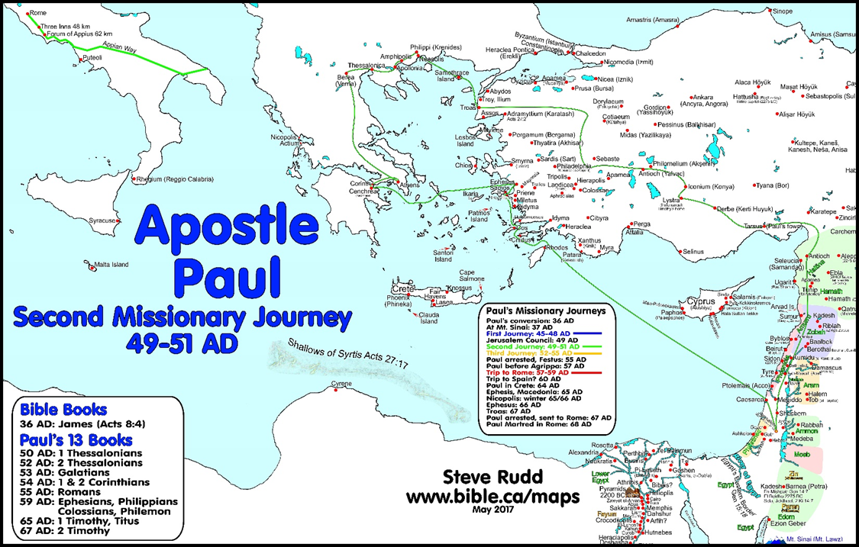

Slide 10
Agenda
Topic one
Topic two
Topic three
Topic four

Slide 11
Introduction
With PowerPoint, you can create presentations and share your work with others, wherever they are. Type the text you want here to get started. You can also add images, art, and videos on this template. Save to OneDrive and access your presentations from your computer, tablet, or phone.

Slide 12
Topic one
Subtitle

Slide 13
Chart

Slide 14
Table
 | Category 1 | Category 2 | Category 3 | Category 4
Item 1 | 4.5 | 2.3 | 1.7 | 5
Item 2 | 3.2 | 5.1 | 4.4 | 3
Item 3 | 2.1 | 1.7 | 2.5 | 2.8
Item 4 | 4.5 | 2.2 | 1.7 | 7

Slide 15
The way to get started is to quit talking and begin doing.
Walt Disney

Slide 16
Team
Name
Title
Name
Title
Name
Title
Name
Title
Name
Title

Slide 17
Timeline
Title
To start a presentation, go to the Slide Show tab, and select From Beginning.
Title
To display Presenter view, in Slide Show view, on the control bar at the bottom left select the three dots, and then Show Presenter View.
Title
During your presentation, the speaker notes are visible on your monitor, but aren't visible to the audience.
Title
The Notes pane is a box that appears below each slide. Tap it to add notes.
Title
If you don’t see the Notes pane or it is completely minimized, click Notes on the task bar across the bottom of the PowerPoint window.

Slide 18
Content
Subtitle
Subtitle
Subtitle
Add text, images, art, and videos.
Add transitions, animations, and motion.
Save to OneDrive, to get to your presentations from your computer, tablet, or phone.
Open the Design Ideas pane for instant slide makeovers.
When we have design ideas, we’ll show them to you right there.
This PowerPoint theme uses its own unique set of colors, fonts, and effects to create the overall look and feel of these slides.
PowerPoint has tons of themes to give your presentation just the right personality.

Slide 19
Summary
With PowerPoint, you can create presentations and share your work with others, wherever they are. Type the text you want here to get started. You can also add images, art, and videos on this template. Save to OneDrive and access your presentations from your computer, tablet, or phone.

Slide 20
Thank you
Presenter name
Email address
Website

