Slide 1
Living In Tents
2 Corinthians 5:1-10

Slide 2
Context of 2 Corinthians
Paul’s apostleship and qualifications in question based on fleshly criteria. (2:17-3:6; 10:8-11)
Influence of the “sophists” (“any orator who emphasized style over substance and received pay for his work”) and the use/emphasis of “emotional delivery” & entertainment over “rational content” and persuasion. (cf., 1 Cor. 2:1-5)
Focus on presentation, delivery and renumeration. (1 Corinthians 9)
Notes:
One of the most difficult lessons Christ's disciples had to learn was that in the kingdom of God, position and power were no evidence of authority. Jesus warned His followers not to pattern their leadership after that of the Gentiles who loved to "lord it over" others and to act important (see Mark 10:35-45). The example we must follow is that of Jesus Christ who came as a servant and ministered to others. Paul followed that example.
But the Corinthians were not spiritually minded enough to discern what Paul was doing. They contrasted his meekness with the "personality power" of the Judaizers, and they concluded that Paul had no authority at all. To be sure, he wrote powerful letters; but his physical appearance was weak, and his speech "unimpressive." They were judging by the outward appearance and were not exercising spiritual discernment.
(The Bible Exposition Commentary. Copyright)

Slide 3
Paul’s Adequacy
Called into question… defended only through his faith in the message he preached from God. (2 Corinthians 3:1-6)
“We have this treasure in earthen vessels, so that the surpassing greatness of the power will be of God and not from ourselves.” (2 Corinthians 4:7)
“Earthen vessels” - insignificant “jars of clay” (ESV) which often held great treasures. “Fragile yet serviceable”
Our usefulness not determined by fleshly criteria. (2 Timothy 2:20-21)
Notes:
Image of small pottery lamps sold in Corinth.

Slide 4
“Treasure in earthen vessels” 2 Corinthians 4:7
The treasure deposited
The earthen vessel
The glorious gospel
Our frail bodies
1 Corinthians 4:1; 9:17; Colossians 2:1-4
2 Corinthians 4:16; Psalms 139:14
Notes:
The treasure is the gospel because of what it provides us. “Treasure in heaven”
Our outer man, as magnificent as it is, is indeed frail. “Fearfully and wonderfully made…” (Psalms 139:13-14
The treasure…
Ps 19:9-10
The fear of the Lord is clean, enduring forever;
The judgments of the Lord are true; they are righteous altogether.
10 They are more desirable than gold, yes, than much fine gold;
Sweeter also than honey and the drippings of the honeycomb.
Ps 119:71-72
t is good for me that I was afflicted,
That I may learn Your statutes.
72 The law of Your mouth is better to me
Than thousands of gold and silver pieces.

Slide 5
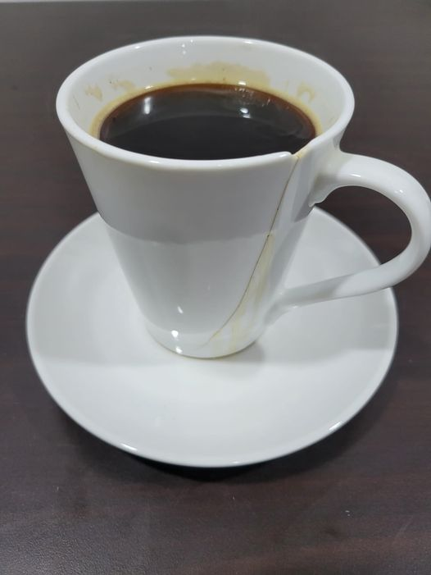
“Treasure in earthen vessels” 2 Corinthians 4:7
Notes:
One of my favorite photos from our recent visit to Malawi is of this cup of coffee. Malawi, like every country, is not a perfect place. Electricity and water service is intermittent; it can be really hard to find fuel; cultural differences can be confounding. So, initially I saw this chipped and cracked cup at our lodging being symbolic of Malawi’s imperfections and asked for a replacement. Yet God had a more important lesson in store...
I soon began to realize that I am this cup. Oh, I like to think of myself as the other side - all perfect and right. I focus on what appears flawless. I forget, or worse ignore, that I am chipped and cracked by a life of sin, stupidity, and selfishness. God, who made me and is perfect, certainly could toss me out. But He did not.
Through His mercy and grace, by sending His Son Jesus out of love for us, I am forgiven. I still bear the consequences of my failings as chips and cracks in the vessel of this body. Yet God still chooses to keep and use me despite this, if I will continue to submit to His will and ways. He created all of us within the womb and planned good works for us to do.
I kept and used this cup every morning. It wept coffee, so I used a saucer, but it did its job until the day we left. I miss it.
It would not surprise me, then, if God also enjoys using and being with me when I submit to His will. As we are told in 2 Corinthians 12:9, "My grace is sufficient for you, for My strength is made perfect in weakness;" in James 4:10, "Humble yourselves in the sight of the Lord and He will lift you up;" and in Psalm 23:5, with the Lord as my shepherd "my cup runneth over."
Thank you, Lord, for retaining me, a cracked but still useful cup in Your house.

Slide 6
“Treasure in earthen vessels” 2 Corinthians 4:8-10
Afflicted
Perplexed
Persecuted
Struck down
Not crushed
Not despairing
Not forsaken
Not destroyed
Notes:
Afflicted – the pressure of circumstances vs. crushed, hemmed in or restrained. There is always a way out.
Perplexed – at a loss as to the way out, not to know which way to turn vs. despairing – to be utterly destitute and at a loss. W/O measures or resources. (The resources were found in the resurrected Christ, vs. 10 and the hope of our own resurrection. Ps. 27:11-14)
Persecuted – harassed, troubled or molested vs. forsaken – abandoned or left behind. (Hebrews 13:5; 10:24; 2 Tim. 4:10, 16)
Struck down – put in a lower place vs. destroyed or put out of the way entirely. (4:3; 1 Cor. 10:9-10; John 3:16; James 4:12

Slide 7
“We do not lose heart…” 2 Corinthians 4:16-18
“Though our outer man (our clay jar) is decaying, yet our inner man is being renewed day by day.” (4:16)
“Momentary light affliction” - “Eternal weight of glory”
“Far beyond all comparison” (Romans 8:18)
Note what Paul’s “jar of clay” had already endured. (11:24ff)
The key is, where is our focus! At the things that are seen (temporal) or unseen (eternal)? (4:18)
Notes:
Image of small pottery lamps sold in Corinth.

Slide 8
A Different Earthly Vessel Considered- A Tent
“For we know that if the tent that is our earthly home is destroyed…” (5:1)
“…we have a building from God, a house not made with hands, eternal in the heavens.”
Note, this is what Jesus was willing to do for us, leave the throne of God to dwell in a tent. (John 1:14; cf., 2 Peter 1:13-14)
Paul longed “break camp”. (Philippians 1:21-23)
Notes:
Disintegrated or demolished. (Matthew 24:2) To halt on a journey (our fleshly journey; Luke 19:7, Jesus halted his journey to stay with Zaccheus)
Perhaps more in line with the idea of a “tent”, our temporal bodies will be taken down or dismantled as a tent.
IE, we break camp!
Remember that Paul was a tent maker.
In John 1:14 we read, “And the Word became flesh and dwelt among us, and we beheld His glory, the glory as of the only begotten of the Father, full of grace and truth.” According to A.T. Robertson, the verb “dwelt” means “to pitch one’s tent or tabernacle” (Word Pictures In The New Testament, Volume V, page 13). What a thought that the Lord of glory left heaven to take up residence in a tent!
When writing to the saints at Philippi he spoke of his conflicting desires. On one hand he desired “to depart and be with Christ” (Philippians 1:23). On the other hand, he wanted to continue in his evangelistic work which would bring fruit from his labor (Philippians 1:22).
The phrase “to depart” is from a Greek military term which means “to break camp” or “strike ones tent” (Marvin Vincent, Word Studies In The New Testament, Volume III, page 425). Paul wrote these words while a prisoner in the barracks of the Praetorian Guard. No doubt Paul had watched Roman soldiers set up their tents and take them down a few days later. Paul was eagerly awaiting the day when his fleshly tent would be taken down for the last time.

Slide 9
Our Vessel, Dwelling, Garment
While “in this tent we groan” (ESV)… Why?
Because the tent is fragile and imperfect and with that comes pain and sorrow. (2 Corinthians 12:7-10)
Because we are “longing” for a “dwelling from heaven”. Do we long to “depart” (“to break camp”, Vincent’s Word Studies) and be with Christ? (Philippians 1:23)
Because we recognize we’re “strangers and exiles (pilgrims) on the earth” (Hebrews 11:13) who are looking for our heavenly home. (Hebrews 11:14-16)
Notes:
Groan “pressed by circumstances" in distress and affliction. To silently pray.
Paul says in verse 3-4, not just to shed this decaying tent, but to be clothed (not naked) with our eternal spiritual dwelling.

Slide 10
Our Vessel, Dwelling, Garment
Are we groaning for a better “tent” or “jar of clay” or for a building from God? (cf., James 5:13; 2 Corinthians 12:7)
What do we “prefer rather (willing, KJV)”? (vs. 8) Refers to a deliberate choice or will.
Many want to make this temporary dwelling permanent. Do we see the danger of getting too comfortable?
What is our attitude towards death? (Eccles. 7:1; 12:7; Philippians 1:21; 1 John 3:1-3)
Notes:
Groan “pressed by circumstances”in distress and affliction. To silently pray.

Slide 11
Therefore…
Our “ambition” is to be “pleasing to Him”. (vs. 9)
Because “we must all appear before the judgment seat of Christ, that each one may be recompensed for his deeds in the body (our tent), according to what he has done, whether good or bad.” (vs. 10)
“Therefore, knowing the fear of the Lord we persuade men” with the glorious gospel. (vs. 11)
We can and ought to have confidence! (1 John 2:28; 3:1-3)
Notes:
What is our ambition in life?
“Ambition” from the Greek “(NT:5389) ‎philotimeomai (fil-ot-im-eh'-om-ahee); to be fond of honor, i.e. emulous (eager or earnest to do something)” (Strong's Concordance with Expanded Greek-Hebrew Dictionary)
Only used 2 other times: Rom. 15:20, “…thus I aspired to preach the gospel…” and 1 Thess. 4:11; “…make it your ambition to lead a quiet life and attend to your own business…”
Refers to what “drives” us, and speaks of our goals and priorities.
We are to be “eager” or “ambitious” to be “pleasing to God”.
That which is acceptable.
We need to be taught and seek to learn what is pleasing to God (Eph. 5:10).
The only way we can please God throughout all eternity is to zealously seek to please Him now in all ways and at all times.

Slide 12
Therefore…
The “love of Christ controls us” that we might sojourn no longer for ourselves (1 Peter 4:2) but for Him who died and rose again on our behalf. (vs. 14-15)
The call to become a “new creature” in Christ. (vs. 17)
The need for “reconciliation”. (vs. 18-21)

