Slide 1
Lessons Learned From Letters To Seven Churches Revelation Chapters 2 & 3
Notes:
The book of Revelation can seem intimidating but a brief consideration of the context will help us glean some important lessons.
“Revelation” simply means “to take the cover off”
Rev. 1:1 - “the things which must shortly take place… and He sent and communicated (signified)” Signified, think John 12:33; 21:19
Likely written during the reign of Caesar Domitian A.D. 81-96 2nd persecutor of Christians. Or else during the first roman persecution of Christians (though less wide spread) around 68 ad just prior to the destruction of Jerusalem.

Slide 2
The Author
“The revelation of Jesus Christ… He sent and communicated it… to John” (1:1)
Jesus Christ… (1:5)
Prophet - “The faithful witness” - (John 8:14)
Priest - “The firstborn of the dead” - (Col. 1:18)
King - “Ruler of the kings of the earth” - (Ephesians 1:20-23)

Slide 3
The Author
Jesus Christ…
Worthy of all reverence and fear. (1:12-17)
“In the middle of the lampstands” or “the churches”. (1:13, 20)

Slide 4
The Audience
“His bond-servants” (1:1) who are enduring great persecution (note 2:10, 13, 22; 3:10; 12:13).
“To the seven churches that are in Asia… to Ephesus… Smyrna… Pergamum… Thyatira… Sardis… Philadelphia… Laodicea.” (1:4, 11)
“Seven”? Troas, Hieropolis, Colossae?
Notes:
4. “To show unto His servants” – Because God cared for His servants and to comfort them in affliction and persecutions and death, God gave this message. He declared within the book that He is greater than “Devil, Caesar, or Rome”. That His power is supreme, and that none can withstand or resist Him without defeat. (Rev. 12:7) This book was written to show them that God is actually on the throne, and that He has perfect control of Destiny, Human government, His people, and all things. This gave His people (church) confidence to trust completely in God (die for Him).
(Troas, Acts 20:5-7; Hieropolis, Colossians 4:13; Colossae, Colossians 1:2)
1. God is writing to the “7” churches in Asia – Since this number (7) stands for “perfection” or “completion”, and since Revelation has been preserved for us by God’s providence, it is to be understood that these churches and their situations and circumstances are representative of the LORD’S CHURCH in its entirety from Pentecost until the end of time. God is using these churches to represent a crosssection of the CHURCH. These churches represent the CHURCH in every stage of spiritual growth, and spiritual malnutrition.
Salutation
Self-designation of the Lord
Commendation
Criticism/Rebuke
Counsel/Warning/Exhortation
Promises of reward to the faithful
Invitation to hear/heed

Slide 5
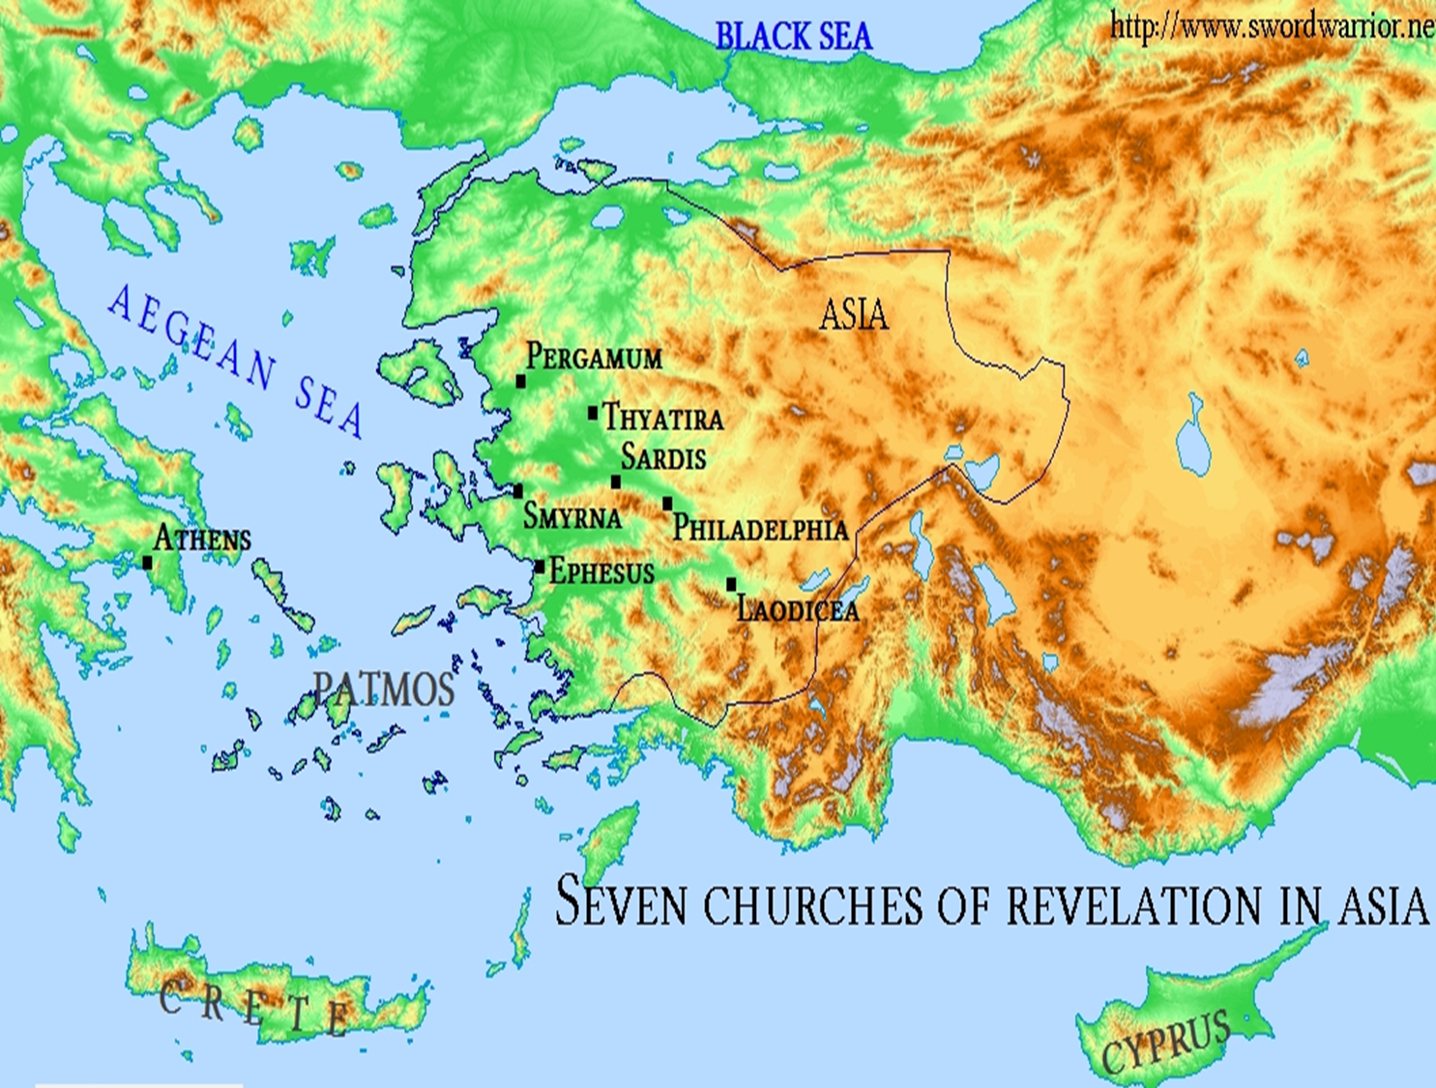

Slide 6
The need for truthful assessment!
Jesus is saying to all churches, “I know…”
Examples of incorrect human assessments:
Smyrna - viewed as being in “poverty” but actually “rich”. (2:9)
Laodicea - viewed as being “rich… wealthy, and have need of nothing” but actually, “wretched… miserable… poor… blind… naked”. (3:17)
Sardis - viewed as being “alive” but actually “dead”.
Notes:
Actually, most have both commendable qualities as well as that which needs to be repented of.
In Smyrna and Philadelphia, no specific rebuke is given but needed to watchful.
In Laodicea, no specific commendation is given but like all, an opportunity to return. (Genesis 4:7)

Slide 7
The need for truthful assessment!
Does Jesus know about us? Is He still “in the middle of the lampstands”? (1:13; John 2:24)
Jesus’ judgments are just and truthful! (Revelation 19:2; Psalms 19:9; John 5:30; 2 Tim. 4:8)
We need to learn to see as God sees! (1 Samuel 16:7)
How do we assess ourselves? Others? (Matthew 7:3-5; Luke 13:1-5; John 7:24; 2 Cor. 13:5)

Slide 8
Commonalities
The need for doctrinal purity!
Receiving both commendation and condemnation.
Ephesus – put to the test false apostles, hate “the deeds of the Nicolaitans”.
Pergamum – some held the “teaching of Balaam” and the “teaching of the Nicolaitans”
Thyatira – the teaching of Jezebel – some did and some didn’t.

Slide 9
The need for doctrinal purity!
Are we “contending for the faith”? (Jude 3)
Do we “test the spirits”? (1 John 4:1)
Do we “receive” those who go beyond the “doctrine of Christ”? (2 John 9-11)
Do we reject any deviations from the sound doctrine? (Galatians 1:6-9; Romans 16:17; 2 Timothy 1:13)

Slide 10
The need for moral purity!
The churches in both Pergamum and Thyatira had succumbed to the lack of moral restraints exhibited in the world they lived in. (2:14; 2:20)
The call to not “soil our garments”. (3:4)
Even those who are “walking and pleasing God” need reminded to “possess his own vessel in sanctification and honor”. (1 Thessalonians 4:1-7)

Slide 11
Commonalities
The need for repentance!
The call to repent (2:5; 2:16; 2:21-22; 3:3; 3:19)
The need to appreciate the patience of God to change! (2 Peter 3:9, 14-15)
How do churches repent?
Consequences of failing to repent! (“or else”, “unless”, “if not… I will…”.
What does repentance demand? (2 Cor. 7:10-11)

Slide 12
Commonalities
The need for perseverance & vigilance!
Indicated by the common exhortation “he who overcomes”. (2:7, 11, 17, 26; 3:5, 12, 21)
Speaks to the great spiritual battle each church and each member must engage in. (Revelation 13:7; 12:7-11; 17:14; 21:7-8)
How do we?

Slide 13
Commonalities
The need to pay attention!
Indicated by the common exhortation “he who has ears to hear, let him hear”. (2:7, 11, 17, 29; 3:6, 13, 22)
Speaks to not only our focus and attention but the need for a tender and receptive heart.
Are we continuing to listen and be stirred up and take it to heart?

Slide 14
All Of The Churches of Christ Need…
True spiritual examination.
Doctrinal purity
Moral purity
Perseverance and vigilance
Spiritual focus and attention.
Penitent hearts

