Slide 1
“The Weight Of The World On His Shoulders”
Jesus In The Garden of Gethsemane
Mark 14:32-42

Slide 2
Before Gethsemane
Jesus predicted His suffering and death. (Matthew 16:21; 17:12, 22-23; 20:17-19)
Jesus already praying about it (Luke 9:28-32) and preparing for it. (Luke 9:51; (cf., Isaiah 50:7) John 12:27)
Ready to lay down His life. (John 10:17-18; cf., 18:1-8)
Notes:
Luke 9:28-32
Some eight days after these sayings, He took along Peter and John and James, and went up on the mountain to pray. 29 And while He was praying, the appearance of His face became different, and His clothing became white and gleaming. 30 And behold, two men were talking with Him; and they were Moses and Elijah, 31 who, appearing in glory, were speaking of His departure which He was about to accomplish at Jerusalem. 32 Now Peter and his companions had been overcome with sleep; but when they were fully awake, they saw His glory and the two men standing with Him.
Luke 9:51
When the days were approaching for His ascension, He was determined (set His face) to go to Jerusalem;
Isa 50:6-7
I gave My back to those who strike Me, And My cheeks to those who pluck out the beard; I did not cover My face from humiliation and spitting.
7 For the Lord God helps Me, Therefore, I am not disgraced; Therefore, I have set My face like flint, And I know that I will not be ashamed.
John 12:27-29
Now My soul has become troubled; and what shall I say, 'Father, save Me from this hour'? But for this purpose I came to this hour. 28 "Father, glorify Your name." Then a voice came out of heaven: "I have both glorified it, and will glorify it again."
John 10:14-18
I am the good shepherd, and I know My own and My own know Me, 15 even as the Father knows Me and I know the Father; and I lay down My life for the sheep. 16 "I have other sheep, which are not of this fold; I must bring them also, and they will hear My voice; and they will become one flock with one shepherd. 17 "For this reason the Father loves Me, because I lay down My life so that I may take it again. 18 "No one has taken it away from Me, but I lay it down on My own initiative. I have authority to lay it down, and I have authority to take it up again. This commandment I received from My Father."
John 18:1-8
When Jesus had spoken these words, He went forth with His disciples over the ravine of the Kidron, where there was a garden, in which He entered with His disciples. 2 Now Judas also, who was betraying Him, knew the place, for Jesus had often met there with His disciples. 3 Judas then, having received the Roman cohort and officers from the chief priests and the Pharisees, came there with lanterns and torches and weapons. 4 So Jesus, knowing all the things that were coming upon Him, went forth and said to them, "Whom do you seek?" 5 They answered Him, "Jesus the Nazarene." He said to them, "I am He." And Judas also, who was betraying Him, was standing with them. 6 So when He said to them, "I am He," they drew back and fell to the ground. 7 Therefore He again asked them, "Whom do you seek?" And they said, "Jesus the Nazarene." 8 Jesus answered, "I told you that I am He; so if you seek Me, let these go their way

Slide 3
Before Gethsemane
The day before…
Observance of the last Passover & washing of the apostles feet. (Mark 14:12-17; John 13:1-20)
Answered who’s greatest. (Luke 22:24-30)
Identification of His betrayer (Mark 14:18-21) & prediction of Peter’s betrayal. (Mark 14:26-31)
Jesus’ prayer for Himself (John 17:1-6), His apostles (John 17:7-19) & for us! (John 17:20-21)

Slide 4
Leaving Jerusalem…
“As was His custom”, (Luke 22:39), they go to the Mount of Olives (Matthew 26:30) where Jesus says that “you all will fall away”. (Matthew 26:31)
After Peter avows he will “never fall away”, Jesus reminds Peter (Matthew 26:33-34; Luke 22:34) that he will deny Him 3 times.
Jesus takes Peter, James and John with Him as He goes to pray. (Mark 14:32-33)
Notes:
Luke 22:39-46
And He came out and proceeded as was His custom to the Mount of Olives; and the disciples also followed Him. 40 When He arrived at the place, He said to them, "Pray that you may not enter into temptation." 41 And He withdrew from them about a stone's throw, and He knelt down and began to pray, 42 saying, "Father, if You are willing, remove this cup from Me; yet not My will, but Yours be done." 43 Now an angel from heaven appeared to Him, strengthening Him. 44 And being in agony He was praying very fervently; and His sweat became like drops of blood, falling down upon the ground. 45 When He rose from prayer, He came to the disciples and found them sleeping from sorrow, 46 and said to them, "Why are you sleeping? Get up and pray that you may not enter into temptation."
Matt 26:30-31
After singing a hymn, they went out to the Mount of Olives.
31 Then Jesus said to them, "You will all fall away because of Me this night, for it is written, 'I WILL STRIKE DOWN THE SHEPHERD, AND THE SHEEP OF THE FLOCK SHALL BE SCATTERED.’
Matt 26:33-35
But Peter said to Him, "Even though all may fall away because of You, I will never fall away." 34 Jesus said to him, "Truly I say to you that this very night, before a rooster crows, you will deny Me three times." 35 Peter said to Him, "Even if I have to die with You, I will not deny You." All the disciples said the same thing too.
Mark 14:32-36
They came to a place named Gethsemane; and He said to His disciples, "Sit here until I have prayed." 33 And He took with Him Peter and James and John, and began to be very distressed and troubled. 34 And He said to them, "My soul is deeply grieved to the point of death; remain here and keep watch." 35 And He went a little beyond them, and fell to the ground and began to pray that if it were possible, the hour might pass Him by. 36 And He was saying, "Abba! Father! All things are possible for You; remove this cup from Me; yet not what I will, but what You will.

Slide 5
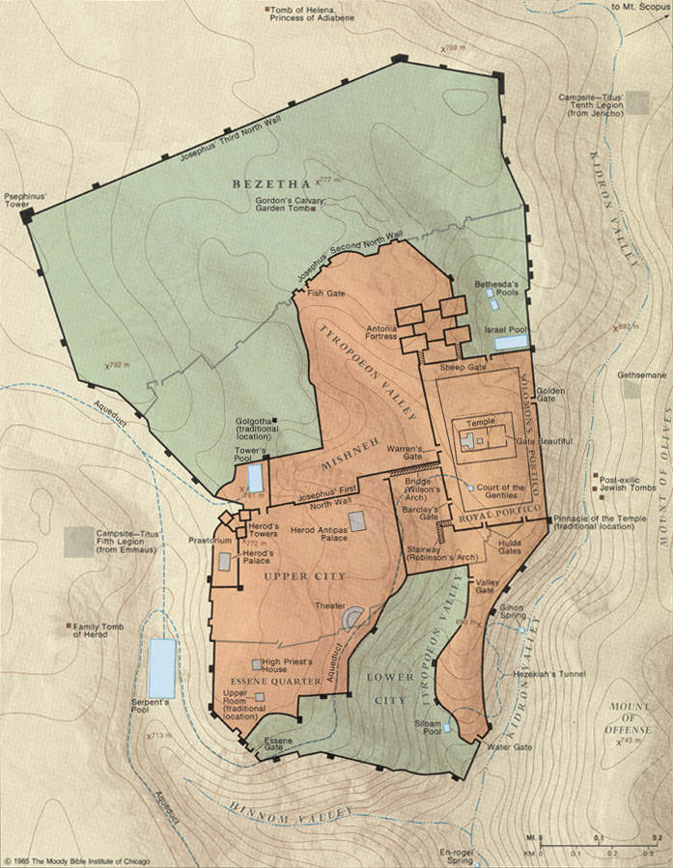
The Garden Of Gethsemane…

Slide 6
Jesus Alone In The Garden…
Jesus “fell on His face” (Matthew 26:39) & was “very distressed and troubled” and said, “My soul is deeply grieved to the point of death; remain here and keep watch.” (Mark 14:33-34)
“Troubled” - uncomfortable, as not at home, to be troubled, distressed: (Thayer’s Lexicon),
“Deeply grieved” - “grieved all around, intensely sad…” (Strong) (Psalms 42:11; Luke 18:23)
Notes:
How Jesus dealt with what is to come from a human perspective.
Distressed - (ekthambeo) NT:1568 "to throw into terror," is used in the passive sense, "to be amazed, affrighted,"(from Vine's Expository Dictionary of Biblical Words)
Deeply grieved - grieved all around, intensely sad, exceedingly sorrowful. Surrounded with grief, (NT Word Pictures) Extreme grief which floods the soul.
Troubled - (ademoneo) NT:85 - uncomfortable, as not at home, to be troubled, distressed: (from Thayer’s Lexicon) According to Lightfoot, ademoneo describes “the . . . restless, half-distracted state, which is produced by . . . mental distress”
In fact, the impact of these words is not adequately felt by looking at them separately, but by taking them all together as they are piled one upon another to describe Jesus’ anguish in Gethsemane.

Slide 7
Jesus Alone In The Garden…
Jesus was “very distressed and troubled” and “fell on His face” (Matthew 26:39)
Why? (Isaiah 53:7) Jesus truly had the “weight of the world” on His shoulders.
Note what “Gethsemane” means!
What is being asked of Him? (Hebrews 5:8)
Notes:
How Jesus dealt with what is to come from a human perspective.
Never read of Jesus “falling on His face” ever before.
Carry the weight of the world on (one's) shoulders - To be struggling with an immense or particularly worrisome burden or responsibility.
Gethsemane - “In order to extract the olive oil, the Jews used an olive press – a “gethsemene.” They lowered heavy stone slabs onto baskets of olives that had already been crushed in the olive crusher. Gradually the enormous pressure of the slab’s weight squeezed the oil out of the olive pulp, and the oil ran into a pit. There it was collected in jars. The image of Gethsemene . . . provides a vivid image of the suffering (Jesus) experienced that night. The weight of the world’s sin pressed down upon Him in the same way a heavy stone slab pressed down upon the olives in the olive press . . . Jesus agonized under the pressing weight of all humanity’s sin . . . As Jesus prayed, the emotional weight of what would be laid on Him was so heavy that it literally squeezed His own blood out of Him (verse 44).” The Weight Of The World Sermon by Jim Moynihan, Luke 22:39-44 - SermonCentral.com

Slide 8
Jesus’ Request Of His Disciples…
“Remain here and keep watch with Me” (Mark 14:34)
Why? (1 Peter 2:21-25; Mark 14:38)
Are we? (1 Thessalonians 5:1-11; Colossians 4:2)
A call for sober mindedness! (1 Peter 5:8-10)
“Pray that you may not enter into temptation” (Luke 22:40; cf., Matthew 6:13)

Slide 9
What Jesus Found In His Disciples…
“He came and found them sleeping…” (Mark 14:37)
“Could you not keep watch for one hour? Keep watching and praying that you may not come into temptation; the spirit is willing, but the flesh is weak.” (Mark 14:38)
A 2nd time, “they did not know what to answer Him.”
A 3rd time “the hour has come…” (Mark 14:41-42)

Slide 10
Jesus’ Request Of His Father…
Jesus again prayed to His Father.
A life of prayer to His Father. (Mark 1:35; Matthew 14:23; Luke 6:12; 9:18, 28-31)
When we turn to God in prayer in a time of crisis or peril, will we be addressing a stranger or a friend? (2 Kings 20:1-6)
The need for persistence & faith. (Luke 11:8; 18:6-8)

Slide 11
Jesus’ Request Of His Father…
“That if it were possible, the hour might pass Him by.” (Mark 14:35; remember John 12:27-28. Also note John 2:4; 8:20)
“Abba! Father! All things are possible for you; remove this cup from Me; yet not what I will, but what you will.” (Mark 14:36)
Sometimes the answer is no. (2 Corinthians 12:7-10)
Notes:
The question was not whether God was able but if thou be willing (ei boulei). Could God find it possible within His will to do something else and still provide for human redemption?
John 12:27-28
Now My soul has become troubled; and what shall I say, 'Father, save Me from this hour'? But for this purpose I came to this hour. 28 "Father, glorify Your name." Then a voice came out of heaven: "I have both glorified it, and will glorify it again."

Slide 12
Jesus’ Submission To His Father…
Note John 12:27-33 - suffering before glory. (Luke 24:26; 1 Peter 5:10; 1:6-7)
Jesus always sought the will of His Father (John 8:29; (cf., John 4:34)
Jesus had a choice to make. (Matthew 26:53)
He chose to drink “the cup”. (John18:11)

Slide 13
Lessons Learned In The Garden…
The power of prayer and the need for watchfulness & sober mindedness. (1 Peter 5:6-7; Hebrews 4:14-16)
Willing to suffer for the cause of Christ for the glory yet to come. (Lk. 24:26; Heb. 2:10; 1 Peter 1:11)

Slide 14
Lessons Learned In The Garden…
Submission to the will of God. (Matthew 6:10; Hebrews 5:8-9)
The need to finish our race. (2 Timothy 4:7-8; John 20:30; Hebrews 4:1)
The need to take advantage of the blood He shed.
The need to live for Him who died for us. (Galatians 2:20; Romans 12:1-2)

