Slide 1
The Purpose And Mission Of The Church
Mt. 16:18;
Eph. 4:4; 1:22-23

Slide 2
– Psalms 127
Ps 127:1, “Except Jehovah build the house, they labor in vain that build it: except Jehovah keep the city, the watchman waketh but in vain.”
In the midst of the Psalms of Ascents, we find the only Psalms attributed to Solomon. As they journeyed toward and within the city, they would see the place that God gave His instructions to build.
The premise of this Psalms – whatever we do, ought to be done with His blessing, i.e. by His authority. Colossians 3:17; 1 Thessalonians 2:13

Slide 3
– Psalms 127
Ps 127:1, “Except Jehovah build the house, they labor in vain that build it: except Jehovah keep the city, the watchman waketh but in vain.”
On the other hand, man attempts to build all sorts of things without God. In time, such things are destined to doom!
The tower of Babel. Genesis 11:1-9.
Haman built gallows to hang Mordecai. (Esther 5:14, 7:9-10).
When God created this world (Hebrews 3:4), He knew exactly what He was doing! The laws He gives us in His word are for our good (Deuteronomy 6:24). Even when I do not know WHY?

Slide 4
– Psalms 127
Ps 127:1, “Except Jehovah build the house, they labor in vain that build it: except Jehovah keep the city, the watchman waketh but in vain.”
Our homes – Psalms 127:3-5 The family shapes a society.
The church – Consider context (Psalms of Ascent). Cf. Matthew 16:18; Ephesians 3:11; Isaiah 2:2
Ephesians 5:24 reminds us that the church is to be subject to Christ (as a wife is subject to her husband).
Our character – Romans 12:1-2; Ephesians 4:17ff
A nation – Proverbs 14:34, “Righteousness exalts a nation, But sin is a reproach to any people.”

Slide 5
The Purpose And Mission Of The Church
Churches of Christ Are Different:
We don’t all believe same thing. 1 Cor. 1:10; Jno. 17:20ff
We don’t all teach same thing. 1 Tim. 1:3; Gal. 1:6-9
We don’t all practice same thing. 1 Cor. 4:17

Slide 7
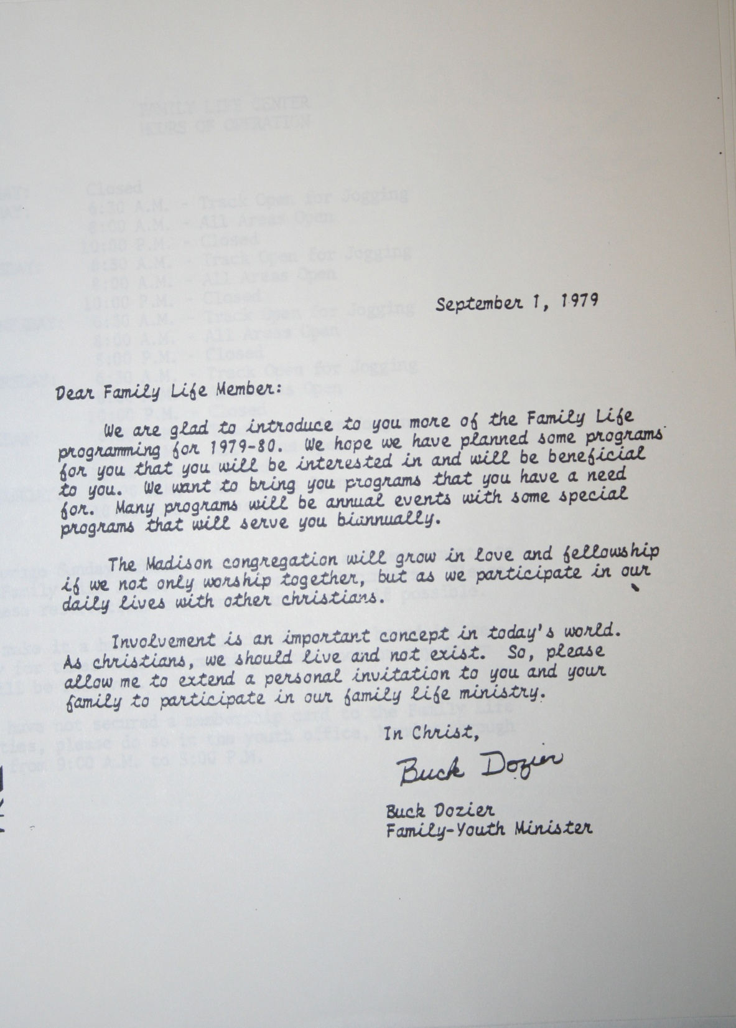

Slide 8
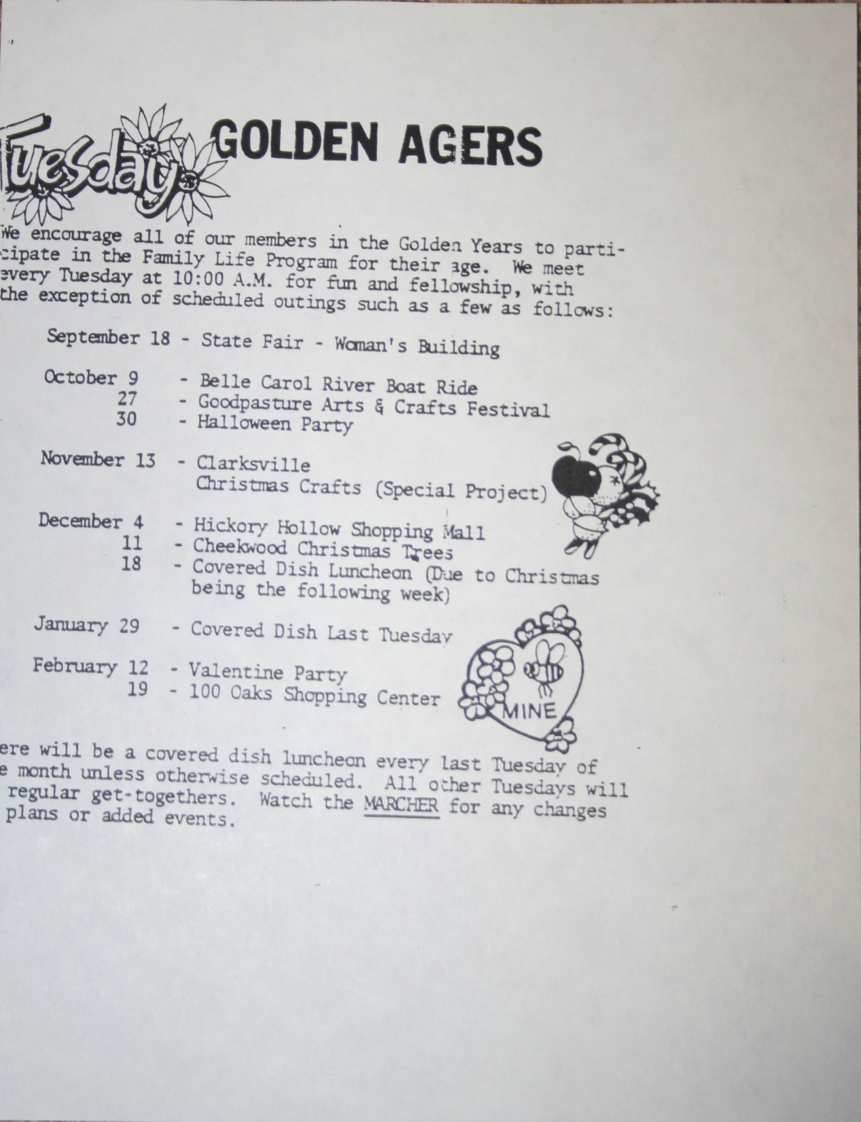

Slide 9
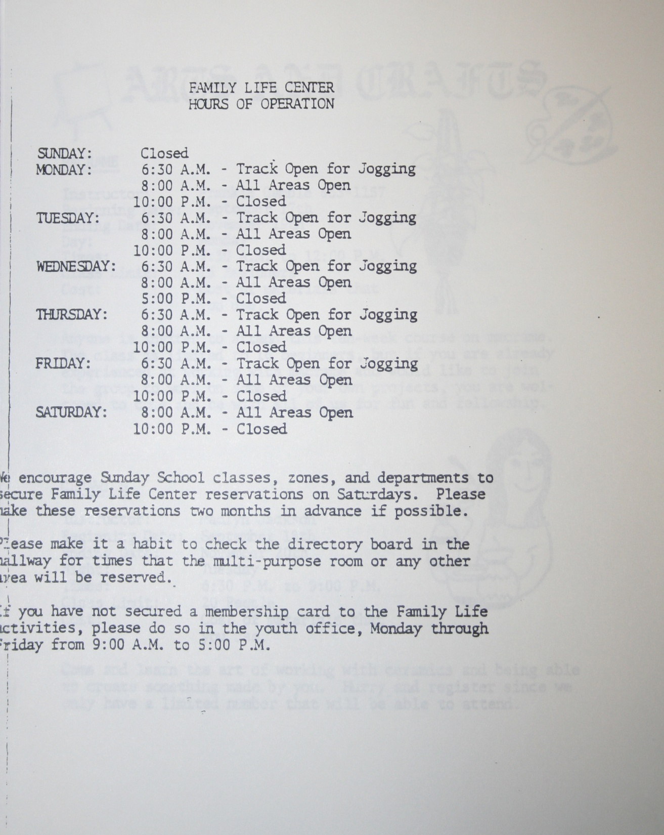

Slide 10
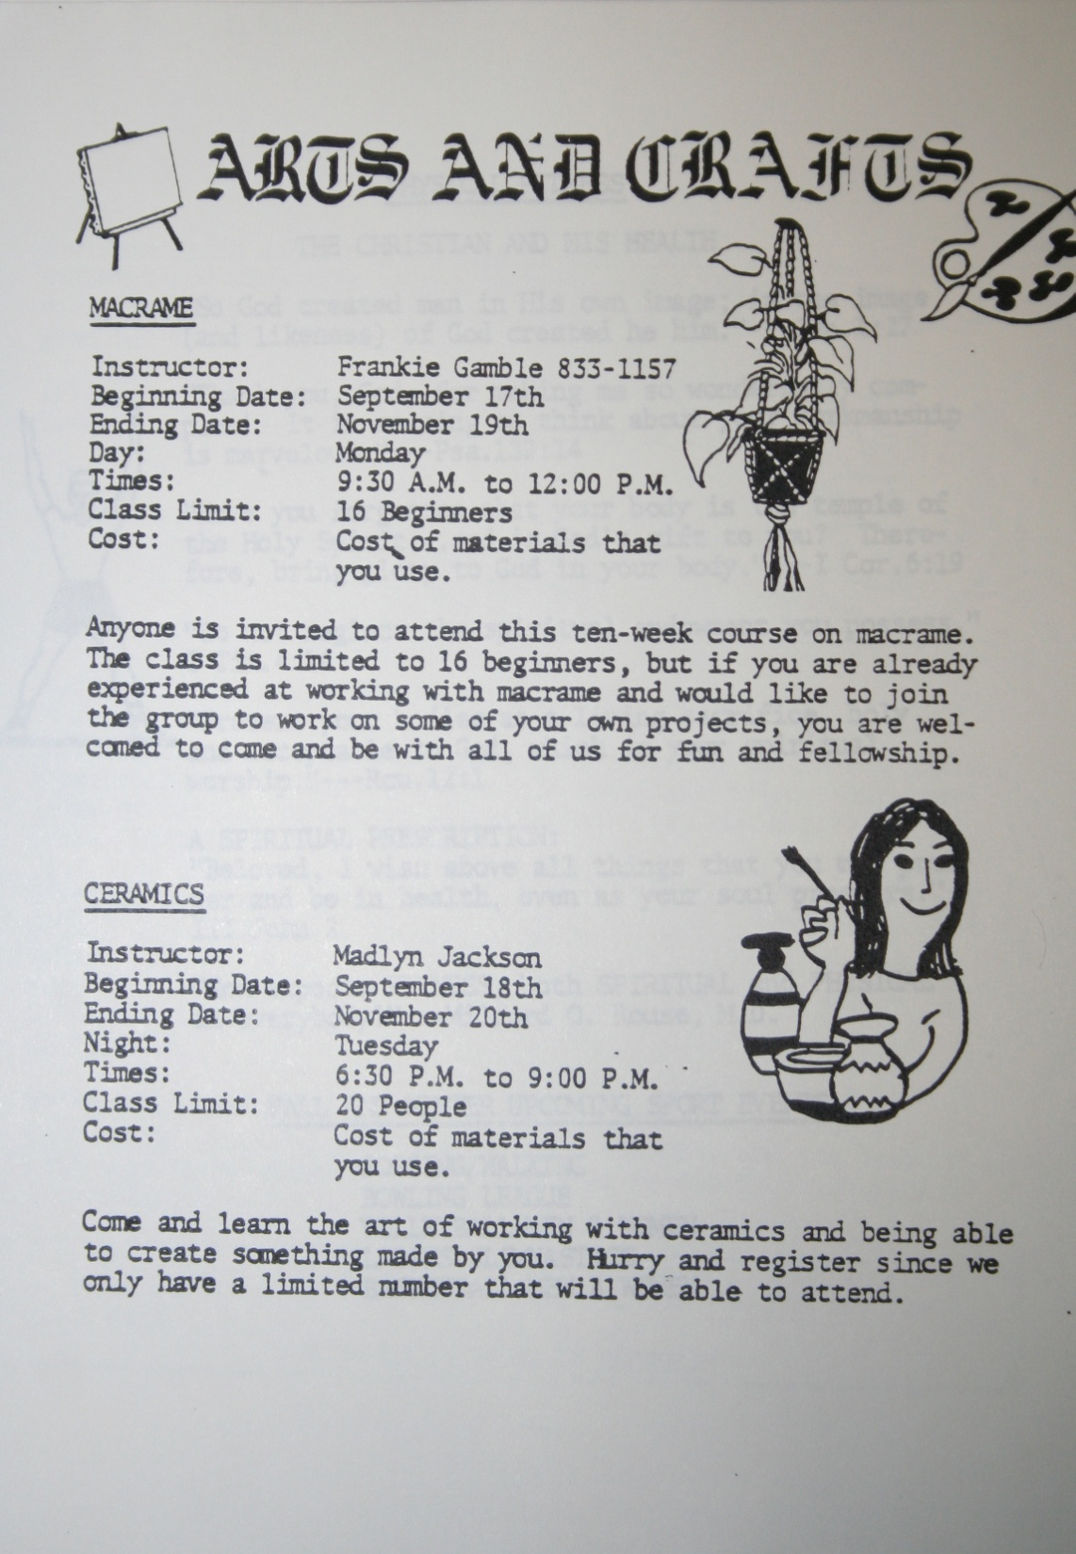

Slide 11
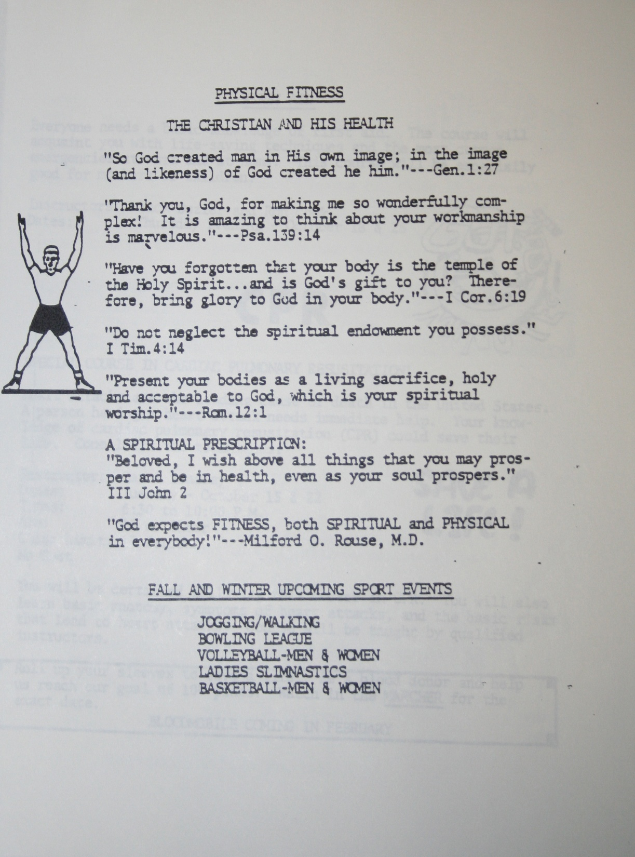

Slide 12
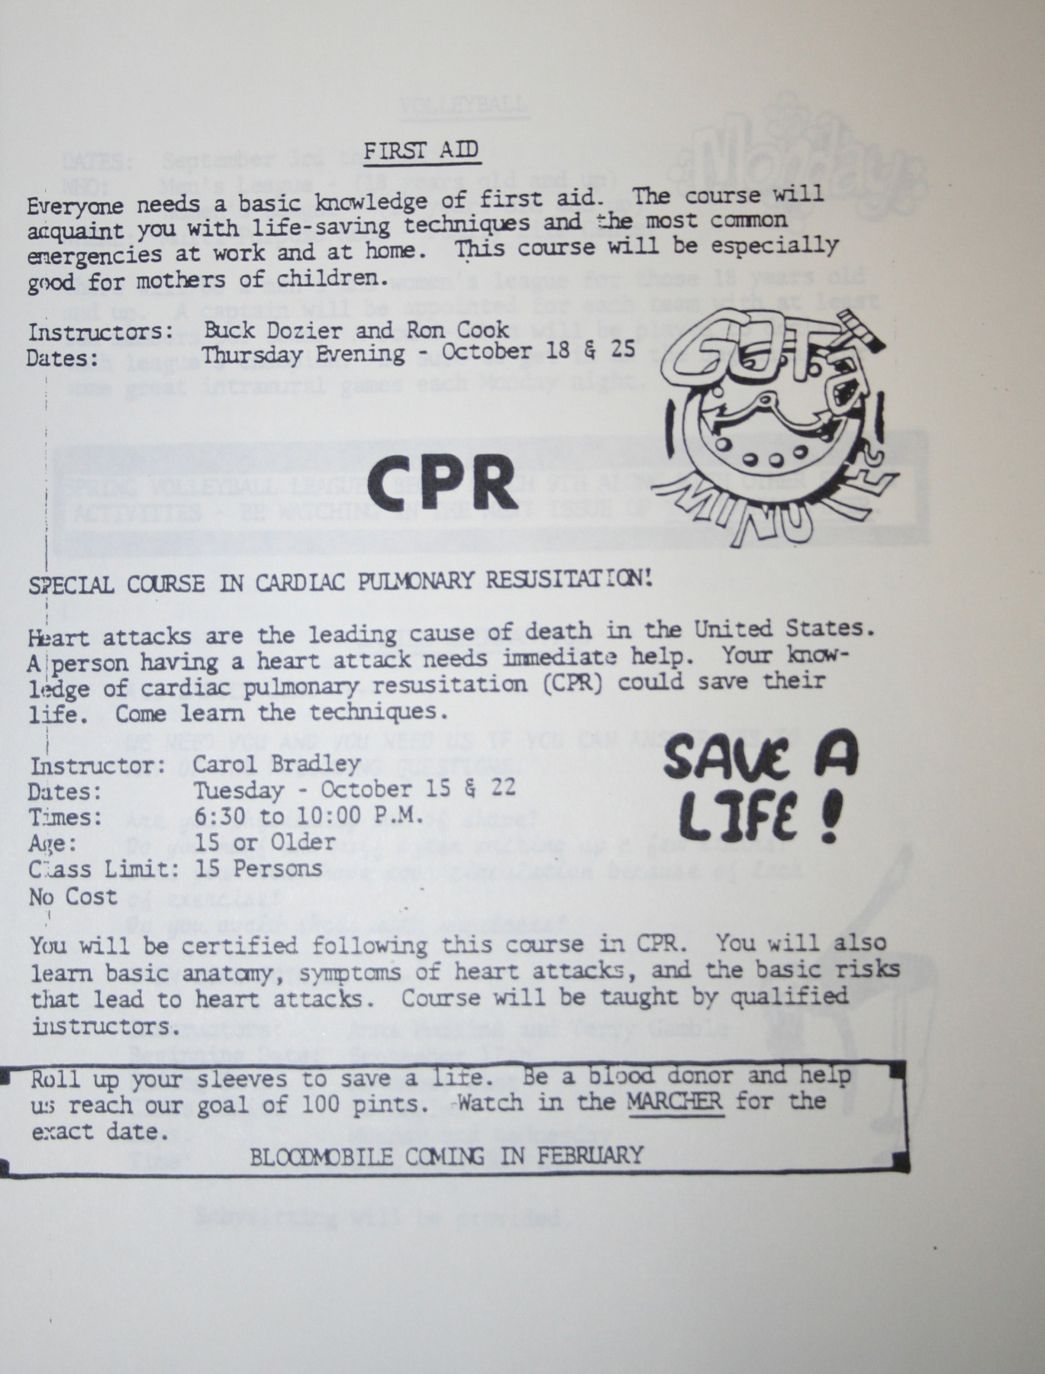

Slide 13
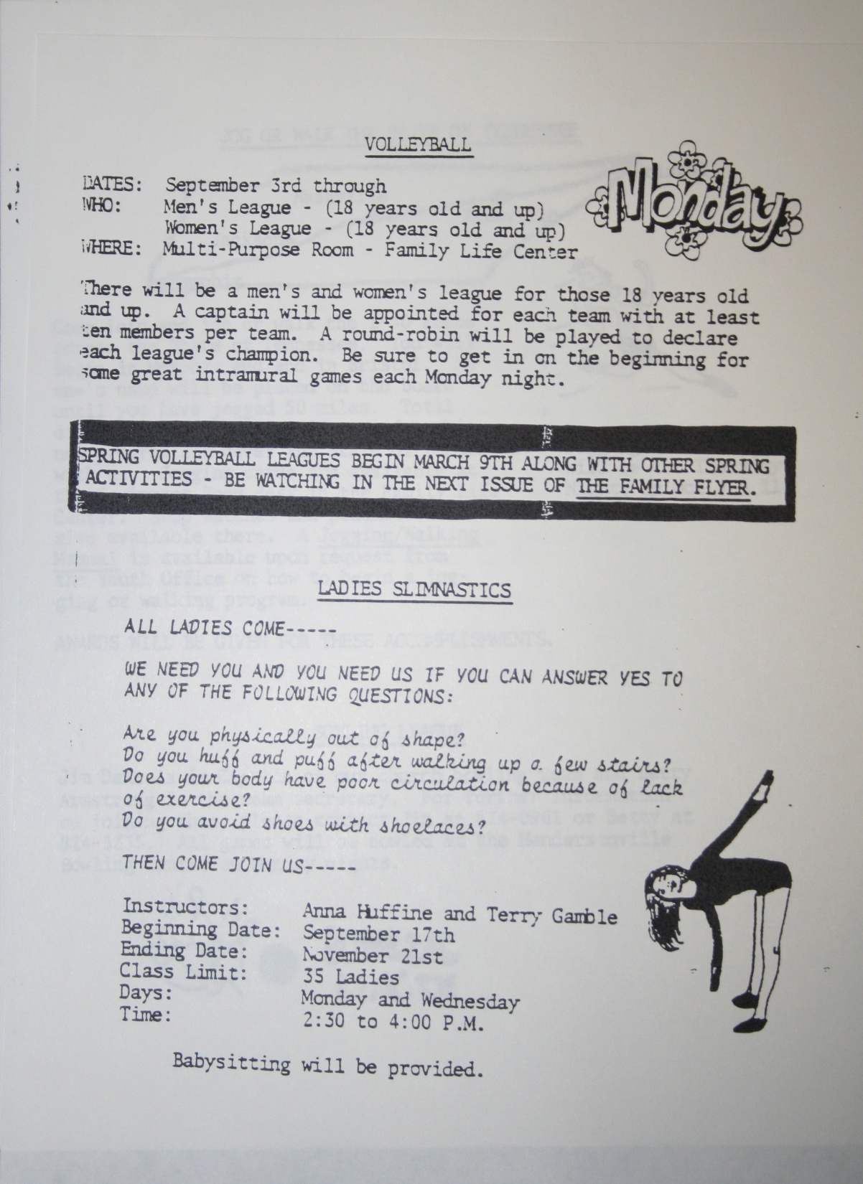

Slide 14
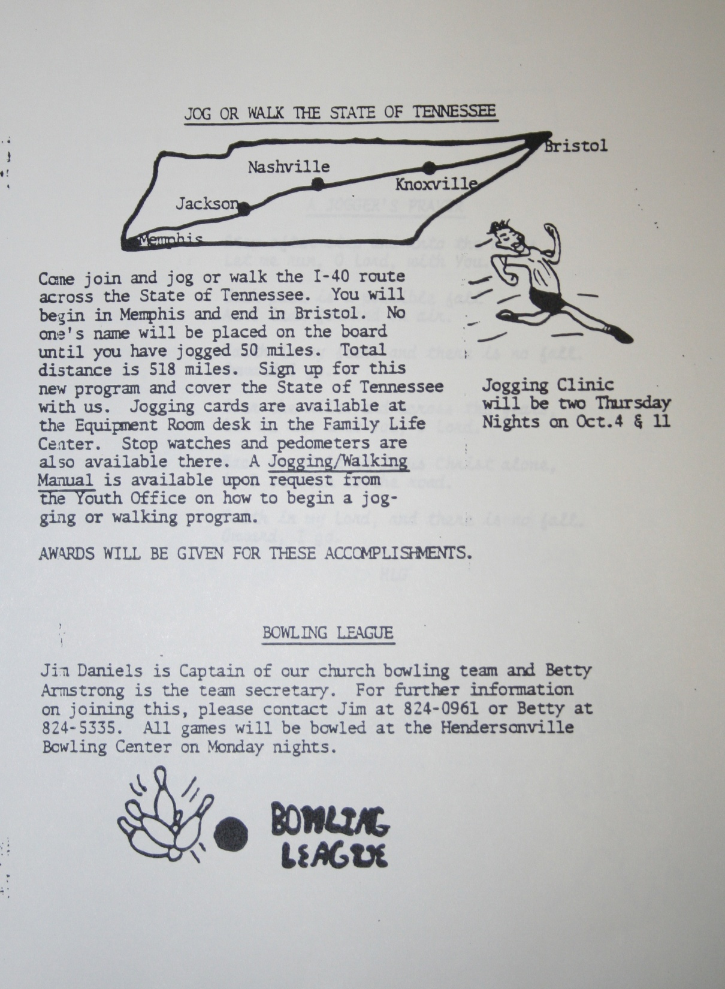

Slide 15
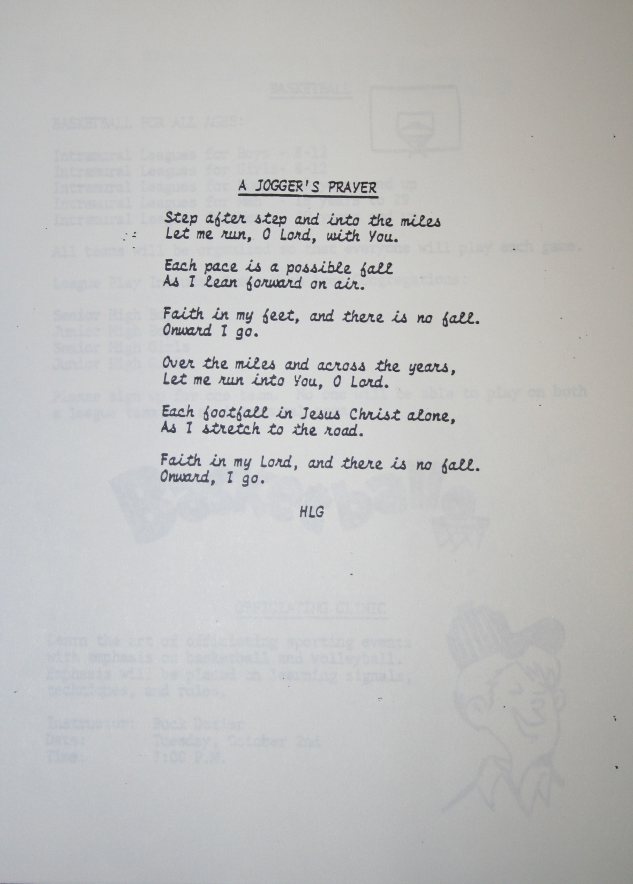

Slide 17
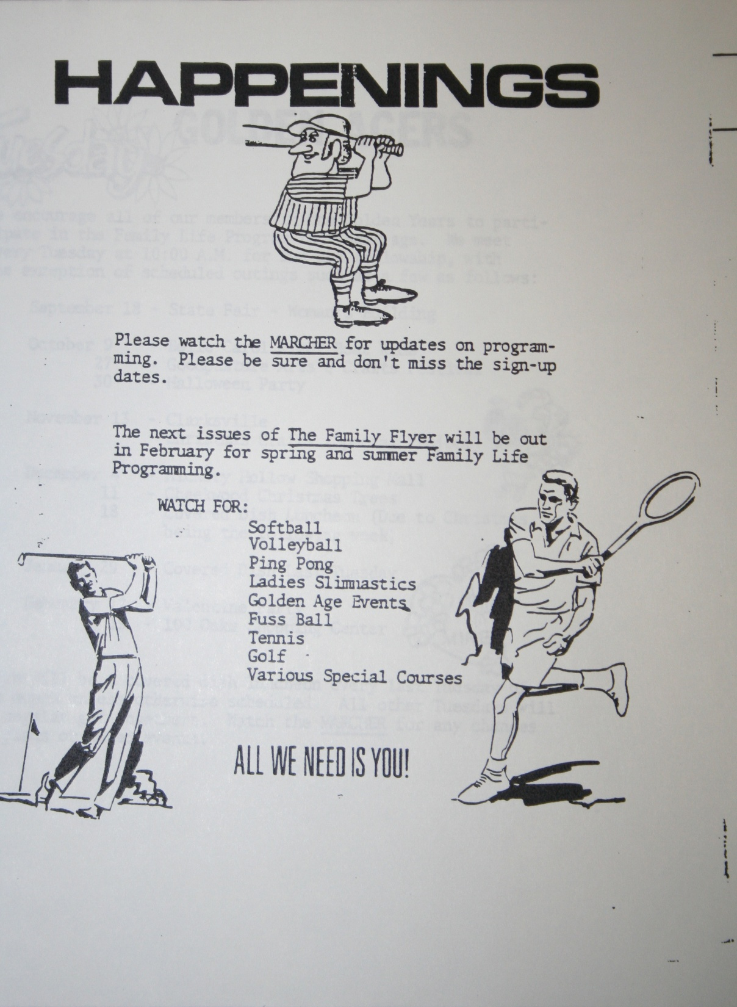

Slide 20
Modern Expressions …
“We do not need authority for everything we do.”
“We do many things for which there is no authority.”
“Where does the Bible say not to?”
A Basic Bible Principle: (1 Pet. 4:11; cf. 2 Jno. 9-11)

Slide 21
Ps 127:1, “Except Jehovah build the house, they labor in vain that build it: except Jehovah keep the city, the watchman waketh but in vain.”
The Chief Priests and Elders of the Jews recognized the Need for Authority. (Mt. 21:23-27)
Question shows two things:
Recognition of a need for authority.
That such authority must come from one who has the right to give it.
Two possible sources:
Heaven
Man

Slide 22
The Bible Says…
There is a pattern. 2 Tim. 1:8-13
Examples. Gen. 4; Lev. 10:1-2; Heb. 8:1-5
We too, must follow the pattern!!!

Slide 23
Church A Spiritual Body With A Spiritual Mission
The Church is the spiritual house of God. 1 Pet. 2:5
It is the family of God built by Christ. Mt. 16:18; Acts 20:28
It is the spiritual body of saved people. Acts 2:47; Eph. 5:23-27

Slide 24
Church Has A Spiritual Mission
The work of evangelism. 1 Tim. 3:15; 1 Thess. 1:8; 1 Cor. 9:14; Acts 11:22; Acts 13:3; Phil. 4:15; 2 Cor. 11:8-9.
This: Not This:
Ch.
preacher
Ch.
M.S.
Or
S.Ch.
Ch.
preacher
Ch.
preacher
Ch.
Ch.
Ch.

Slide 25
Church Has A Spiritual Mission
The work of Edification. Eph. 4:11-16; 1 Cor. 14:26; Col. 2:6-7
church
Place
Personnel
Provisions

Slide 26
Church Has A Spiritual Mission
Work of Benevolence. (Limited, 1 Tim. 5:16)
This:
Not This:
Acts 2,4,6
Acts 11:27
Reason for giving:
“that there might be equality”
2 Cor. 8:14
1 Cor. 16:1-3
2 Cor. 8-9
Rom. 15:25ff

Slide 27
What The Mission Of The Church Is Not:
Political...
The kingdom of Christ is not an earthly political force, Jno. 18:33-38
God ordained civil government to meet all such issues. Rom. 13:1-7; 1 Pet. 2:13-17
Although individual Christians are subject to the powers that be, the church and state are distinct in mission and separate in function.

Slide 28
What The Mission Of The Church Is Not:
Economical…
Only evil men make "godliness a way of gain," 1 Tim. 6:5
God gave the church a pattern by which to finance its work, 1 Cor. 16:1-2; 2 Cor. 9:7
Farming, manufacturing, or merchandising is simply not the function of the church.

Slide 29
What The Mission Of The Church Is Not:
Social.
The kingdom of God is not "eating and drinking," Rom. 14:17; Cf. 1 Cor. 11:22,34
NOTE: Those who followed for the "fishes and loaves" turned back when the word seemed "hard" to them, Jno. 6:26, 60-66, cf. Jno. 6:26-27

Slide 30
The Social Gospel
NOTE: Social activities, recreation, and benevolence were never offered in N.T. days as the means by which to get people to become Christians. THE GOSPEL IS GOD'S DRAWING POWER BY WHICH TO CALL MEN. 2 Thess.2:14; Rom. 1:16
Are these things worthy of the blood of Jesus Christ? Cf. Eph. 5:25; Acts 20:28

Slide 31
CONCLUSION:
No man has the right to distort the energy, strength, zeal or resources of the church of our Lord to serve human aims or purposes.
We must let the church be distinct as the church, so adorned as to glorify the head–even Christ.
God gave His Son for it.
The Lord of glory died for it.
We must not bring its lofty mission down to serve the outward man, but rather we must keep it pure to serve the interest of heaven for which we must strive.

