Slide 1
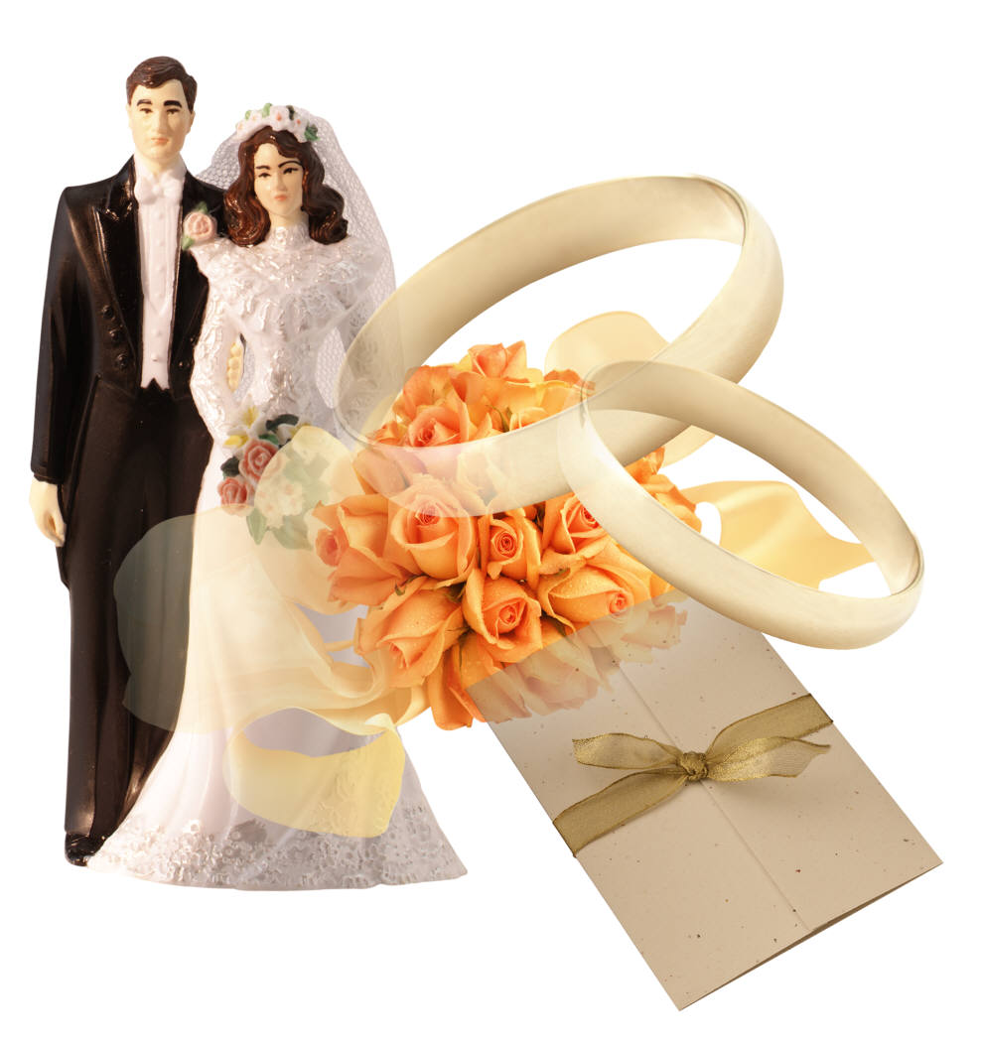
The Honorable Institution Of Marriage
Marriage is good.
Gen. 2:18-24;
Deut. 6:24
Marriage is honorable.
Heb. 13:4

Slide 2
– Psalms 127
Ps 127:1, “Except Jehovah build the house, they labor in vain that build it: except Jehovah keep the city, the watchman waketh but in vain.”
In the midst of the Psalms of Ascents, we find the only Psalms attributed to Solomon. As they journeyed toward and within the city, they would see the place that God gave His instructions to build.
The premise of this Psalms – whatever we do, ought to be done with His blessing, i.e. by His authority. Colossians 3:17; 1 Thessalonians 2:13

Slide 3
– Psalms 127
Ps 127:1, “Except Jehovah build the house, they labor in vain that build it: except Jehovah keep the city, the watchman waketh but in vain.”
On the other hand, man attempts to build all sorts of things without God. In time, such things are destined to doom!
The tower of Babel. Genesis 11:1-9.
Haman built gallows to hang Mordecai. (Esther 5:14, 7:9-10).
When God created this world (Hebrews 3:4), He knew exactly what He was doing! The laws He gives us in His word are for our good (Deuteronomy 6:24). Even when I do not know WHY?

Slide 4
– Psalms 127
Ps 127:1, “Except Jehovah build the house, they labor in vain that build it: except Jehovah keep the city, the watchman waketh but in vain.”
Our homes – Psalms 127:3-5 The family shapes a society.
The church – Consider context (Psalms of Ascent). Cf. Matthew 16:18; Ephesians 3:11; Isaiah 2:2
Ephesians 5:24 reminds us that the church is to be subject to Christ (as a wife is subject to her husband).
Our character – Romans 12:1-2; Ephesians 4:17ff
A nation – Proverbs 14:34, “Righteousness exalts a nation, But sin is a reproach to any people.”

Slide 5
Marriage is under attack
A recent Pew Forum survey said 39 percent of Americans believe marriage is obsolete.
The U.S. Census reports that 41 percent of births in America are to parents who are unmarried.
Today nearly 69 percent of American adults believe sex between an unmarried man and woman is morally acceptable. (Statista Research Department), Jun 15, 2023
JUNE 5, 2023 Gallup Poll: U.S. Same-Sex Marriage Support Holds at 71%

Slide 6
“You can’t choose your sexuality, but you can choose Jesus. Now you can choose a Bible, too.” ©2012, QueenJamesBible.com. All rights reserved.

Slide 7
Learn God’s Law Gen. 2:18-25
Ordained by God. Mt. 19:4-6
Covenant (oath) witnessed by God. Mal. 2:14
Honorable & to be honored by all. Heb. 13:4
Governed & judged by God. Rom. 7:1-3

Slide 8
Learn God’s Law Gen. 2:18-25
Universal in scope. Gen. 2:21-22; (Mt. 19:4; Mk. 10:2-12); cf. Mt. 14:3-4; Cf. 1 Cor. 6:9-11
Provides companionship. Gen. 2:18-20 (Prov. 2:17)
Prevents immorality. Gen. 2:25; 1 Cor. 7:1-2 ; (Prov. 5:15-20)

Slide 9
Learn God’s Law Gen. 2:18-25
Who Can Marry?
One who – never been married. Mt. 19:5-6
One who put their mate away for fornication. Mt. 5:32; Mt. 19:9
One whose mate is dead. Rom. 7:2-3

Slide 10
NOTE: Divorced People Remain Under The Constraint Of Divine Law!!!
Deut. 24:1-4 Divorce wife BUT can't have her back after her 2nd marriage.
Deut. 24:1-4 Divorcee marry another BUT then can't ever return to 1st mate.
Lev. 21:7, 13-14 Divorce free from marriage BUT can't marry a priest.
1 Cor. 7:10-11 May require one to “remain unmarried.”

Slide 11
Learn God’s Law Gen. 2:18-25
Permanent (Rom. 7:2; 1 Cor. 7:39)
Leave his father and mother
Marriage is the primary relationship
Marriage is for life- ONE EXCEPTION. Mt. 19:9

Slide 12
Learn God’s Law Gen. 2:18-25
Thrives on mutual commitment
Cleave (be joined) to his wife Cf. Deut 10:20 “Thou shalt fear Jehovah thy God; him shalt thou serve; and to him shalt thou cleave”
Engenders faithfulness, respect and understanding, trust and security, contentment and happiness

Slide 13
Learn God’s Law Gen. 2:18-25
Union of two lives into one (Mt. 19:6)
They shall become one flesh.
Jesus: “No more two, but one flesh.”
Christ & His church. Eph. 5:22, 28-32

Slide 14
Maintain An Honorable Name Eccl. 7:1 “A (good) name is better than precious oil”
Boaz could say of Ruth, “all the city of my people doth know that thou art a worthy woman.” Ruth 3:11
If you would have the best, be worthy of the best.
If there is ever a time to “sow wild oats,” it is not during the years of youth. Cf. Gal. 6:7-8; Eccl. 12:1

Slide 15
Mature Enough To Make Sound Judgments. Cf. 1 Tim. 2:9; Tit. 2:4-6
Children should not get married. 1 Cor. 13:11
Growing up is a part of preparation for marriage.

Slide 16
Cultivate Friendships With The Honorable People. 1 Cor. 15:33
Be careful where you shop for a companion. Good marriages, like good houses are made from the best materials. (cf. Rom. 12:1-2)
It is the virtuous or worthy woman whose price is far above rubies (Prov. 31)… It is the finest young man who will make the best husband.

Slide 17
Do Not Marry A Stranger.
He/She may have ruined the lives of others... Cf. Prov. 7:24-27
The best predictor of the future is the past... get to know the person.

Slide 18
Accept Responsibility.
Young men should be prepared to make a living. 1 Tim. 5:4,8
Young woman must also learn responsibilities. Tit. 2:4-5
Both should accept the responsibility of leaving father and mother. Gen. 2:24

Slide 19
Both Partners Should Be Christians. (Want to go to heaven more than anything else!)
Children are to be brought up in the nurture and admonition of the Lord. Eph. 6:4
In looking for the proper person to marry, remember, that you are looking for just one.

Slide 20
In Preparation For Marriage…Learn Restraint. 1 Cor. 6:18; Gen. 39:7-12
There is a natural attraction between a man and a woman. It is good and holy, God put it there, but not without restraint. Heb. 13:4
Gal. 5:19-21 Sins of the lust of the flesh.
Fornication: Any unlawful sexual intercourse.
Uncleanness: Any thing that defiles the body, makes it impure.
Lasciviousness: Shameless conduct, absence of restraint, indecency, excessive indulgence.

Slide 21
Learn To Be Fair And Honest With Yourself.
Do not deceive yourself.
Listen to the advice of others.
Use a just balance. Prov. 11:1; 16:11; 20:10; 20:23; 1 Cor. 6:9; 15:33; Gal. 6:7; Jms. 1:16 “Be Not Deceived..”

Slide 22
Date Honorable People
Marriage is an exclusive, lifelong decision. Mt. 19:6
Rule Of Thumb: If he (or she) is not fit for a MATE, he (or she) should not be considered for a DATE!!!

Slide 23
The Honorable Institution Of Marriage.
Know God’s laws.
Maintain an honorable name.
Mature.
Cultivate friendships with honorable people for one’s lifetime companion will come from these associates.

Slide 24
Conclusion:
Do not marry a Stranger.
Accept responsibility.
Be a Christian and marry a Christian.
Learn restraint.
Learn to be fair and honest with yourself.

