Slide 1
The Influence Of The World On The Church, And The Church On The World
Ephesians 4:17ff

Slide 2
Ancient Greece
"In Greece there has never been any shame in relationships before marriage or outside marriage. Demosthenes writes as if it was the merest commonplace, as indeed it was: ‘We keep mistresses for pleasure, concubines for the day-to-day needs of the body, but we have wives in order to produce children legitimately and to have a trustworthy guardian of our homes.’" (Barclay, Flesh & Spirit, p. 24)

Slide 3
Roman Empire
Morality during 1st half of the 2nd century
"…an age when shame seems to have vanished from the earth." (J. J. Chapman, cited in Flesh & Spirit, Barclay, p. 24)

Slide 4
Roman Empire
Adultery
"Roman women were married to be divorced & were divorced to be married. Some of them distinguished the years, not by the names of the consuls, but by the names of their husbands." (Seneca, cited in Flesh & Spirit, Barclay, p. 24 )

Slide 5
Roman Empire
Homosexuality
Julius Caesar was notoriously the lover of King Nicomedes of Bithynia.
Nero "married" a youth called Sporus & had a marriage procession through the streets of Rome (Flesh & Spirit, Barclay, p. 27)

Slide 6
Roman Empire
"There was no strong body of opinion against immorality. To the Graeco-Roman world immorality in sexual matters was not immorality; it was established custom and practice." (Flesh & Spirit, Barclay, p. 28)

Slide 7
America, 2021
“The latest results are based on Gallup's annual Values and Beliefs poll, conducted May 1-13, 2020. The poll updated several trends on Americans' views about marriage asked previously over the past two decades.
The trends are consistent with Americans' evolving views of marriage. Sixty-six percent now believe it is morally acceptable to have a baby outside of marriage, an increase from 53% the first year the question was asked in 2001. Seventy-two percent, up from 53% in 2001, consider sex between an unmarried man and woman morally acceptable.”
(https://news.gallup.com/poll/316223/fewer-say-important-parents-married.aspx)

Slide 8
America, 2021
Belief That It Is Very Important for Couples to Marry if They Plan to Spend the Rest of Their Lives Together
2006 2013 2020 Change, 2006-2020
% pct. pts.
Men 56 43 39 -17
Women 53 43 38 -15
18-34 years old 50 34 29 -21
35-54 years old 46 41 40 -6
55+ years old 67 54 43 -24
Married 60 49 43 -17
Not married 45 37 33 -12
Children under 18 56 40 43 -13
No children under 18 54 45 36 -18
Attend church weekly 82 68 67 -15
Attend church monthly 62 50 46 -16
Seldom/Never attend 33 26 22 -11
(https://news.gallup.com/poll/316223/fewer-say-important-parents-married.aspx)

Slide 9
“You can’t choose your sexuality, but you can choose Jesus. Now you can choose a Bible, too.” ©2012, QueenJamesBible.com. All rights reserved.

Slide 10
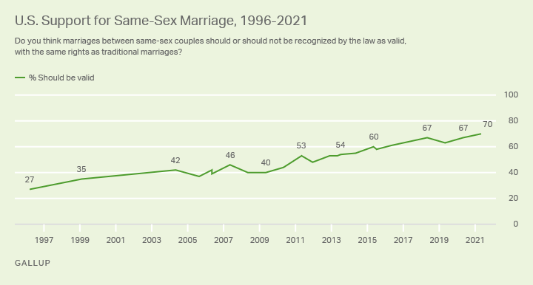
America, 2021
JUNE 8, 2021
Record-High 70% in U.S. Support Same-Sex Marriage
https://news.gallup.com/poll/350486/record-high-support-same-sex-marriage.aspx

Slide 11
The Loss Of Hunger For Righteousness
The Influence Of The World On The Church
“Prophesy not unto us right things, speak unto us smooth things, prophesy deceits” (Isa. 30:10)
“Blessed are those who hunger and thirst for righteousness, for they shall be satisfied.” (Mt. 5:6; Note 1 Pet. 2:1)
Revealed in the GOSPEL is God’s plan to make man righteous. Rom. 1:16-17

Slide 12
The Loss Of Hunger For Righteousness
The Influence Of The World On The Church
What will the next generation be? Judg. 2:10
Fear of losing our young people turns the church into a social club.

Slide 13
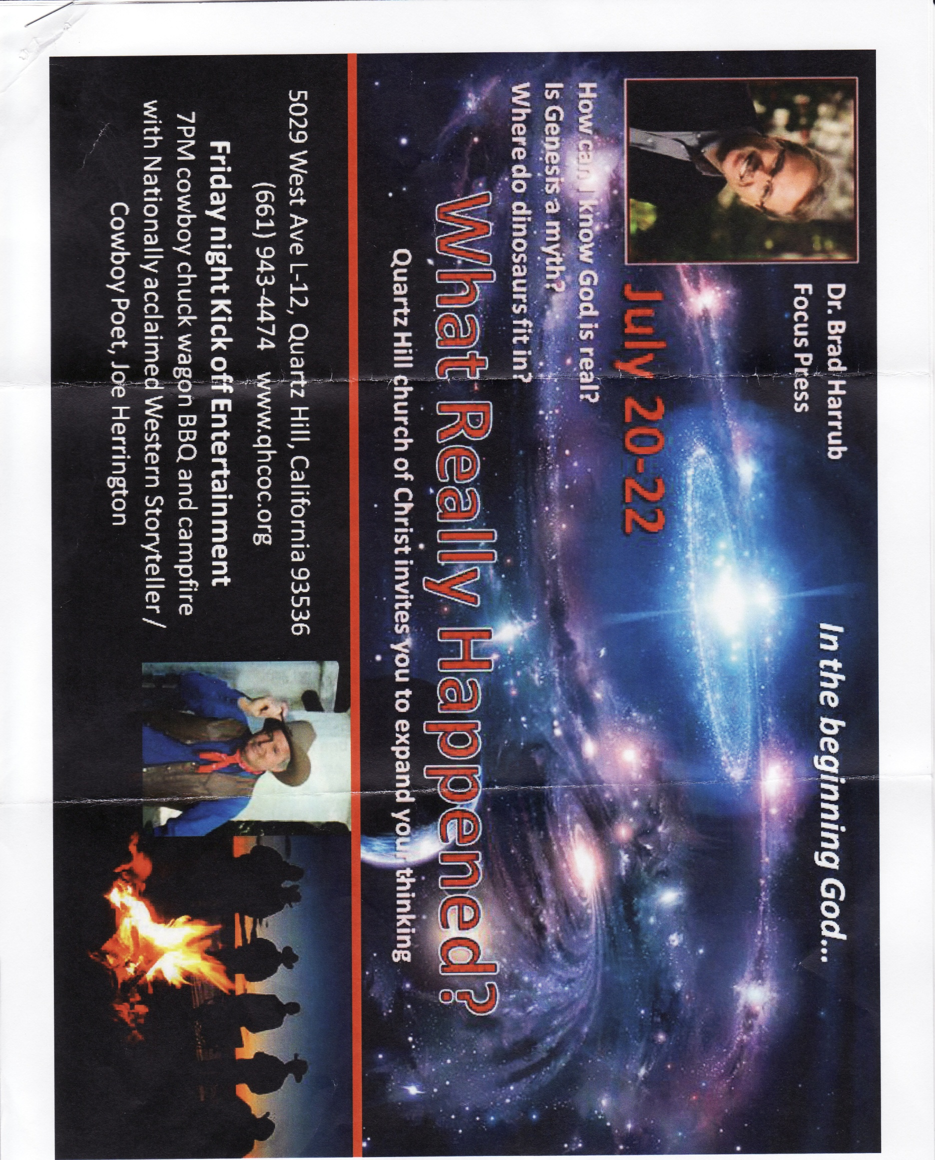
2012

Slide 14
The Loss Of Hunger For Righteousness
The Influence Of The World On The Church
Faithfulness – The result of teaching. (Cf. Tit. 2:11-14)
Motivated to greater evangelism.
If viewed the people from - spiritual condition. (Eph. 2:1-2)
If view them without hope. (Eph. 2:12)

Slide 15
The Loss Of The Sacred
The Influence Of The World On The Church
Sacred -- “to be devoutly revered.” (Thayer)
2 Tim. 3:15 “And that from a babe thou hast known the sacred writings which are able to make thee wise unto salvation through faith which is in Christ Jesus.”

Slide 16
The Loss Of The Sacred
The Influence Of The World On The Church
Illustrations of the Sacred.
Sabbath day. (Ex. 20:8; cf. Num. 15:32-36)
Moses drew near the burning bush in the wilderness, God said, “Draw not nigh hither: put off thy shoes from off thy feet, for the place whereon thou standest is holy ground” (Ex. 3:5)
Nadab and Abihu. “I will be sanctified in them that come nigh me, and before all the people I will be glorified” (Lev. 10:3).

Slide 17
The Loss Of The Sacred
The Influence Of The World On The Church
Illustrations of the Sacred.
Jews in Nehemiah’s day, when the law was read. (Neh. 8:5)
“Let us have grace, whereby we may offer service well-pleasing to God with reverence and awe: for our God is a consuming fire” (Heb. 12:28-29).
NOTE: To treat what is holy, “sacred” as if it were common profanes it.

Slide 18
The Loss Of Distinctiveness
The Influence Of The World On The Church
Distinctions in Scripture. 1 Pet. 2:9
Wide way from the narrow way. (Mt. 7:13-14)
Wise from the foolish. (Mt. 7:24-27)
Kingdom of darkness from the Kingdom of Christ. (Col. 1:13-14)

Slide 19
The Loss Of Distinctiveness
The Influence Of The World On The Church
Distinctions In Scripture.
One way from all others. (Jno. 14:6)
One gospel from all others. (Gal. 1:6-9)
One body from all others. (Eph. 1:22-23; 4:4)
One baptism from all others. (Eph. 4:5)
Truth and error. (Eph. 4:14-15)

Slide 20
The Loss Of Distinctiveness
The Influence Of The World On The Church
We cannot blend God’s way with man’s way. (Prov. 14:12)
Desire of the people for a king. (1 Sam. 8; Deut. 17)
Peter’s desire to build three tabernacles. (Mt. 17:1-5)

Slide 21
The Loss Of Confrontation
The Influence Of The World On The Church
Immodest attire, filthy language, fornication, adultery, homosexuality…
Must preach the whole counsel of God. (Acts 20:27)

Slide 22
The Loss Of Confrontation
The Influence Of The World On The Church
God Despises Sin
Prov. 15:9 “The way of the wicked is an abomination to Jehovah”
Prov. 28:9 “He that turneth away his ear from hearing the law, Even his prayer is an abomination.”

Slide 23
The Loss Of Confrontation
The Influence Of The World On The Church
The Gospel Is Confrontational
Evangelism is not possible without confrontation. (Cf. Acts 2:36; 3:12-15; 4:8-10)
Repentance commanded. (Acts 17:30-31)
Accountable!
Paul called on churches to put to death the deeds of the body. (Col. 3:5-11)

Slide 24
The Influence Of The World On The Church
The Loss Of The Godly Home
The Loss Of Hunger For Righteousness
The Loss Of The Sacred
The Loss Of Distinctiveness
The Loss Of Confrontation

Slide 25
Changes Occur
The World Changes
Religious conditions change. Exodus 32; Judges 2:10ff; 1 Samuel 8; 1 Timothy 2:11-12; 1 Corinthians 14:34-35; Matthew 19:9; 2 Timothy 3:14
Ecclesiastes 1:10 “Is there a thing whereof it may be said, See, this is new? it hath been long ago, in the ages which were before us.” ASV

Slide 26
…And The Influence of the Church On The World
Ephesians 4:16-5:11

Slide 27
… The Influence of the Church On The World
Christians Must Not Overlook The Importance Of Righteousness In A Wicked World.
Christians are the salt of the earth. Matthew 5:13; Proverbs 14:34 “Righteousness exalteth a nation; But sin is a reproach to any people” Cf. Genesis 18:23-33
Sin is likened to leaven. 1 Corinthians 5:6
Christians can make a difference. Cf. Titus 2:11-12

Slide 28
… The Influence of the Church On The World
We Must Teach Our Children How To Live In A Wicked World.
1 John 5:19 “We know that we are of God, and the whole world lieth in the evil one.”
Deuteronomy 4:9-10; 6:6ff; 20ff; Deuteronomy 31:9-13; etc.
Exodus 12:24; Joshua 4:20ff
Ephesians 6:4

Slide 29
… The Influence of the Church On The World
There Is Reason For Optimism.
Romans 1:16-17 “For I am not ashamed of the gospel: for it is the power of God unto salvation to every one that believeth; to the Jew first, and also to the Greek. For therein is revealed a righteousness of God from faith unto faith: as it is written, But the righteous shall live by faith.”
NOTE: 2 Timothy 4:2-4

Slide 30
Mark 16:15 “Go ye into all the world, and preach the gospel to the whole creation.”
The “unlikely” just may listen and obey.
Religious/Gentile – Cornelius (Acts 10)
Non-Religious – Simon (Acts 8:9-13)
Worldly – Corinthians ( Acts 18:8; 1 Corinthians 6:9-11)
Ignorant – Jews (Acts 2:23; 3:17)
Persecutor – Saul (Acts 8:3; 9:1-2; 1 Timothy 1:15)
Political – Jailor (Acts 16:31-33)

Slide 31
Mark 16:15 “Go ye into all the world, and preach the gospel to the whole creation.”
Gospel Message – Redemption / Salvation
How we are saved? (1 Corinthians 15:1-4)
Peter’s sermon – salvation from sin. (Acts 2)
Peter’s sermon to Cornelius. (Acts 10:34-43)
Paul’s sermon in Antioch. (Acts 13:23-38)
Paul’s sermon in Thessalonica and on Mars Hill – salvation. (Acts 17:6, 22-31)
Paul’s letter to the Romans. (Romans 1:1-7)

Slide 32
… The Influence Of The Church On The World
The Sinful State Of The World Can Help Christians To Shine. Matthew 5:13ff; Philippians 2:14-16; 1 Timothy 4:12
World often sees hypocrisy. Cf. 1 Timothy 4:1-2; Matthew 23:15, 29-33
John 5:44 “How can ye believe, which receive honor one of another, and seek not the honor that cometh from God only?”
Micah 6:8 “He hath showed thee, O man, what is good; and what doth Jehovah require of thee, but to do justly, and to love kindness, and to walk humbly with thy God.”

Slide 33
The Influence Of The World On The Church, And The Church On The World
Depends On YOU TODAY.
Joshua 24:15
“And if it seem evil unto you to serve Jehovah, choose you this day whom ye will serve; whether the gods which your fathers served that were beyond the River, or the gods of the Amorites, in whose land ye dwell: but as for me and my house, we will serve Jehovah.”

