Slide 1
Where Have You Come From & Where Are You Going?
Genesis 16:8

Slide 2
Context -
Promises to Abram and Sarai (Genesis 12:1-7; 15:1-6) but no offspring.
Sarai’s Egyptian handmaid. (Genesis 16:1)
Sarai proposes to Abram that she obtain children through Hagar. (Genesis 16:2-4)
Notes:
“Faith in a God whose promise takes too long” is difficult”

Slide 3
Context -
Hagar “despised” Sarai and Sarai blames Abram who “punts” and tells Sarai to “do what is good in your sight”. (Genesis 16:5-6)
Sarai treats her “harshly” and Hagar “fled from her presence.” (Genesis 16:6)

Slide 4
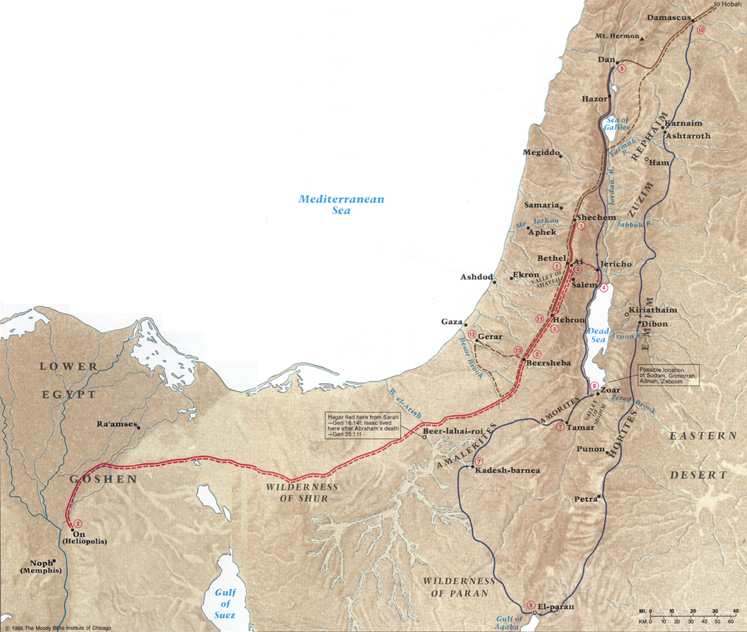
Hagar travels through the wilderness at Shur seeking sustenance on her way back to Egypt.
The sustenance she finds is not only physical but spiritual.

Slide 5
Hagar is promised descendants “too many to count” through a son that exercise his will - who will “matter”.
She then named God “Elroi” meaning “You, God see me.” (John 4:15-19)
Notes:
For Hagar, a slave-girl with no power, who has been beaten and battered—this is good news. This is hope and redemption.
First person to be spoken to by an angel of God recorded in scripture.
First woman given promises.
Only person to give a name to God. (EL ROYI - a God who sees)

Slide 6
Hagar, where have you come from?
Not always an easy question to answer.
In the immediate context, she is running away from her problems & difficulties… Who hasn’t at some point?
Our past includes both consequences of our own choices and that which may be out of our control. (Daniel?)
Notes:
For Hagar, a slave-girl with no power, who has been beaten and battered—this is good news. This is hope and redemption.

Slide 7
Where have you come from?
Moses? (Exodus 3:1-9)
Daniel? (Daniel 1:1-8)
Jonah? (Jonah 1:1-3, 8-10)
Paul? (Philippians 3:4-6)
Jesus? (Philippians 2:5-8)
Notes:
For Hagar, a slave-girl with no power, who has been beaten and battered—this is good news. This is hope and redemption.

Slide 8
Hagar, where are you going?
She had a choice to make…
Will you return back to your former manner of life?
Will you return in submission to God?
Not enough to flee, we must pursue. (1 Timothy 6:11; 2 Timothy 2:22)
Notes:
Must be deliberate and purposeful - qualities to put off and put on.

Slide 9
Where are you going?
Moses? (Exodus 3:1-9)
Israelites? (Numbers 14:1-4)
Daniel? (Daniel 1:1-8)
Jonah? (Jonah 1:1-3, 8-10)
Paul? (Acts 9; Philippians 3:4-6)
Demas? (2 Timothy 4:10)
Jesus? (Philippians 2:5-8)
Notes:
For Hagar, a slave-girl with no power, who has been beaten and battered—this is good news. This is hope and redemption.

Slide 10
Lessons Learned From Hagar -
God desires/requires submission. For God to bless her, she would need to choose to return to Sarai and “submit yourself to her authority”.
To His will (James 4:7; 1 Peter 5:6; Matthew 16:24-25)
To one another (Ephesians 5:21ff; 1 Peter 2:13-20; note vs. 21ff; example, Philemon 10-16)
For God’s sake, for conscience sake. (1 Peter 2:19)
Notes:
Abram and Sarai had their own submission they needed to learn to exercise and they had their own sins to address. All needed to learn to walk by faith and wait for God to bring about His promises.
The angel tells Hagar to go back (and to submit yourself to her authority – reminds me of Paul to Onesimus going back to Philemon – God can use any who are willing to “submit” for God’s sake. This is what Peter discusses in 1 Peter 2:13-20. Does God promise that Sarai will treat her better?
Does God say all conflicts will go away? God says trust me and Hagar does.) . Everything in my body wants to tell Hagar, “No! Don’t go back! Are you crazy?” But the angel gives her a promise, that her offspring will be numerous, maybe as numerous as the stars. She will bear a son, and call him Ishmael.
All human wisdom would say don’t go back… yet God says to do so trusting in His promises.

Slide 11
Lessons Learned From Hagar -
God desires/requires submission.
She, who perhaps couldn’t choose before, now must!
Only God can bless our broken roads going forward. (Matthew 11:28-30; Luke 7:44-50)
Notes:
Abram and Sarai had their own submission they needed to learn to exercise and they had their own sins to address. All needed to learn to walk by faith and wait for God to bring about His promises.

Slide 12
Lessons Learned From Hagar -
God knows & cares.
He sees us (Genesis 16:13; Luke 7:44-50; John 4:35; Psalms 33:13ff)
He hears us (Genesis 16:11, “the Lord has given heed to (heard) your affliction”. “Ishmael” means “God hears”; John 9:31)
Notes:
Ps 33:13-22
The Lord looks from heaven; He sees all the sons of men; 14 From His dwelling place He looks out On all the inhabitants of the earth, 15 He who fashions the hearts of them all, He who understands all their works. 16 The king is not saved by a mighty army; A warrior is not delivered by great strength. 17 A horse is a false hope for victory; Nor does it deliver anyone by its great strength.
18 Behold, the eye of the Lord is on those who fear Him, On those who hope for His lovingkindness, 19 To deliver their soul from death And to keep them alive in famine. 20 Our soul waits for the Lord; He is our help and our shield. 21 For our heart rejoices in Him, Because we trust in His holy name. 22 Let Your lovingkindness, O Lord, be upon us, According as we have hoped in You.
God sees Hagar for who she truly is; and Hagar in turn sees God for who God truly is.

Slide 13
Where Have We All Come From?
We are all created by God in His image with the ability to choose. (Acts 17:25-28; Isaiah 45:9; Genesis 1:27; Ephesians 4:22-24)
We have all come from a past in which we chose to commit sin which has separated us from Him. (Romans 3:23; Isaiah 59:1-2)
All of us have been presented with a choice. (Titus 3:3-5)

Slide 14
Where Are We All Going?
Our daily choices determine:
Whether to a place of glory, honor, immortality and eternal life, or
A place of wrath, indignation and tribulation (Romans 2:4-10).
Two choices: Matthew 7:13-14; cf., Luke 16:19ff

