Slide 1
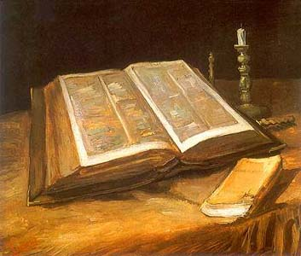
BIBLE – IS LIFE UNFAIR?
JOHN 1:10-11

Slide 2
WE LIVE IN A SIN CURSED WORLD
Gen. 1:1-13
Gen. 3:17-19
1 Jn. 2:15-17
2 Tim. 4:10
James 4:4
Matt. 5:45

Slide 3
WE MUST LIVE WITH BAD CHOICES OF OTHERS
Deut. 28:1-6,15-19
Ezek. 18:20
Ezek. 20:5-10
John 15:20
2 Tim. 3:12
Josh. 7:20-21

Slide 4
WE MUST LIVE WITH OUR BAD CHOICES
Mark 16:15-16
Luke 23:39-42
1 John 1:7-9
Ezek. 18:25
2 Pet. 3:10-13

Slide 5
CONCLUSION
Is life sometimes unfair? Why?
We live in a sinful world.
We live with the bad choices of ourselves as well as others.
Remember Jesus when life seems unfair!
Turn to him today!!!

