Slide 1
The Faith Of Abraham
Hebrews 11:8-19

Slide 2
Walking through the OT scriptures
Lessons in the Garden of Eden. (Genesis 1-3)
Lessons learned from Cain and Abel. (Genesis 4)
Lessons learned from Noah and the flood. (Genesis 6-7)
Lessons learned from the promises to Abraham and his faith in God. (Genesis 12)

Slide 3
5 Key Old Tesatment Passages
Genesis 3:15 - God’s promise of Satan’s defeat.
Genesis 12:1-3 - God’s promise of blessing to all the nations of the earth through Abraham.

Slide 4
Abraham: the Christian’s model of faith
We must have the faith that surrenders all to God.
We must be “those who are of the faith of Abraham”. (Romans 4:16; Gal. 3:7; cf., 2 Peter 1:3)
Our call to become Abraham’s seed. (Gal. 3:29; cf., vs. 26-27)
We must “do the deeds of Abraham” by faith (John 8:39; cf., Luke 3:8)
Notes:
The Christian’s understanding of God’s promise to produce a universal blessing through Abraham far exceeds Abraham’s understanding. The Christian knows the full meaning of the promise, knows the ultimate fulfillment of that promise was achieved in the death and resurrection of Jesus, and knows the ultimate objective was the opportunity for all people to have salvation in Christ. He has the written Word. He can see God working through history to keep that promise.
Yet, the best any Christian can hope to do is to equal the faith of Abraham. God’s purpose began to take its earliest earthly form in Abraham because he was capable of having a faith which God could reckon for righteousness. It is that same faith which will allow the Christian to be righteous before God.

Slide 5
Background of Abraham
About 2,000 years after the creation and about 2,000 years before Christ and 400 years after the flood.
God used Abraham to preserve righteousness as Noah did.
Notes:
Abram left a city thought to have had 500,000 people, two-storied houses, some with running water, to become a nomad dwelling in tents (Heb. 11:8).

Slide 6
Background of Abraham
From Ur of Chaldea where he lived until about age 70 in a very idolatrous, yet cultured and abundant environment.
Abraham had two brothers; Nahor and Haran. Haran died in Ur before God called him. (Genesis 11:27-32)
Lot was the son of Haran.
Abraham’s father was named Terah.
Notes:
Abram left a city thought to have had 500,000 people, two-storied houses, some with running water, to become a nomad dwelling in tents (Heb. 11:8).
Ur had hot and cold running water, a sewer system, multistory buildings, paved roads, major temples, ornate furniture, and a variety of metal instruments. The Sumerians developed a sexagesimal system that divided the hour into 60 minutes, the minute into 60 seconds, and the circle into 360 degrees—a system that we still use today. There were well developed law codes and a standard system of weights and measures. There was a system of canals connecting the Tigris and Euphrates river valleys to control floods and provide irrigation so farming could go on year-round. At the time of Abraham, Ur would have been on or very near the shore of the Persian Gulf, in the Euphrates River delta, though the vast amounts of sediment carried by the Tigris and Euphrates Rivers have since filled in about 150 miles of the original gulf. There was probably a port on the gulf shore that was alive with trade and fishing boats.
the artifacts from Abraham’s Ur are among the most impressive of all. Their craftsmanship is finer, more luxurious, better, than most of what came later.
If Abraham was a wealthy man in Ur, as he appears to have been, he must have possessed many treasures of the finest craftsmanship and the most exquisite materials. He would have lived in a mansion in Ur that would probably still look impressive today. As an upper class, free man, he would have attained a high level of education and must have been literate and fluent in Sumerian, Akkadian, various other Semitic languages (e.g., Amorite, Aramaic), and probably Egyptian as a trade language. He would have enjoyed a refined urban life in a highly advanced center of civilization. To leave all of this in order to journey to Canaan would have meant a huge sacrifice of material comfort for Abraham. Abraham lived in a tent in Canaan, not in a house, and he lived in rugged fields, deserts, and mountains, away from the conveniences of civilization. Whereas Ur had a perpetually dry and sunny climate with a stable water supply from rivers, Canaan had a far messier and more unpredictable climate, with rain, snow, frost, dew, and so forth. The only two centers of advanced civilization near Canaan were Egypt and Sodom, both of which were spiritually problematic and outside of the area where God wanted Abraham to live.
https://truthonlybible.com/2015/02/13/ur-of-the-chaldees-abrahams-original-home/

Slide 7
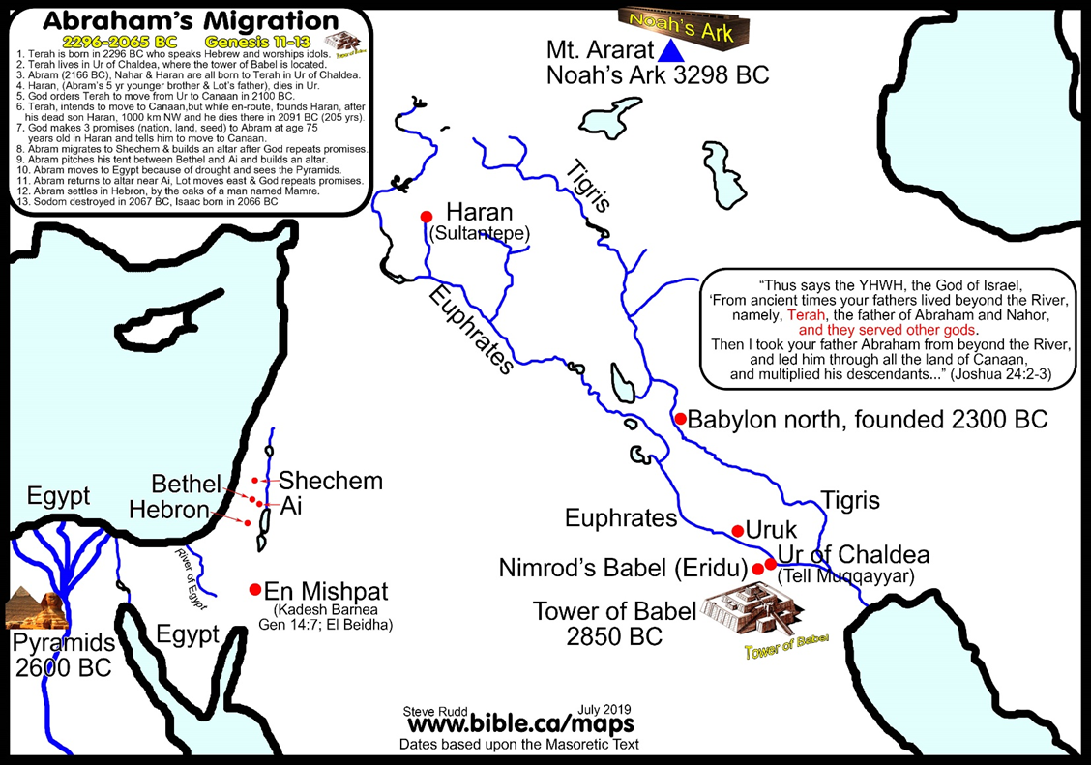
Background of Abraham
From Ur of Chaldea
About 2,000 years after the creation and about 2,000 years before Christ.

Slide 8
Background of Abraham
We might ask, how did Abraham come to believe in God in such an idolatrous environment?
Remember Romans 10:17!

Slide 9
Background of Abraham
While in such a wicked environment, God called to Abraham to “leave your country and your relatives, and come into the land that I will show you.” (Acts 7:3-4)
Abraham’s father, brother and nephew all came with him as far as Haran (Genesis 11:31) where they spent about 5 years and where his father Terah died.
Notes:
Acts 7:2-6
And he said, "Hear me, brethren and fathers! The God of glory appeared to our father Abraham when he was in Mesopotamia, before he lived in Haran, 3 and said to him, 'LEAVE YOUR COUNTRY AND YOUR RELATIVES, AND COME INTO THE LAND THAT I WILL SHOW YOU.' 4 "Then he left the land of the Chaldeans and settled in Haran. From there, after his father died, God had him move to this country in which you are now living. 5 "But He gave him no inheritance in it, not even a foot of ground, and yet, even when he had no child, He promised that HE WOULD GIVE IT TO HIM AS A POSSESSION, AND TO HIS DESCENDANTS AFTER HIM.
Gen 11:31-32
Terah took Abram his son, and Lot the son of Haran, his grandson, and Sarai his daughter-in-law, his son Abram's wife; and they went out together from Ur of the Chaldeans in order to enter the land of Canaan; and they went as far as Haran, and settled there. 32 The days of Terah were two hundred and five years; and Terah died in Haran.

