Slide 1
“Seeing their faith…”
Mark 2:1-5

Slide 2
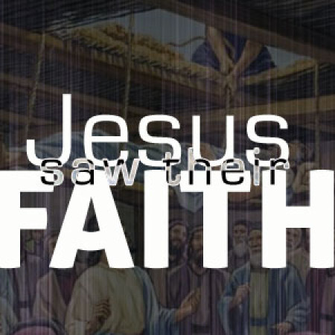
Jesus Heals a Paralytic at Capernaum
Matthew 9:2-8
Mark 2:1-12
Luke 5:17-26
“Seeing their faith” (Mark 2:5)
For these 5 men, it was demonstrated by their determination and persistence in seeking Jesus and His healing.
Notes:
Faith is usually described in nebulous terms of a “better felt than told” feeling.
Jesus saw faith as something demonstrated.

Slide 3
Jesus Heals a Paralytic at Capernaum
Matthew 9:2-8
Mark 2:1-12
Luke 5:17-26
Who do we show our faith to?
God (Hebrews 11:17-19)
A sinful world (Matthew 5:13-16)
Our Brethren (Heb. 10:23-25)
Our families (2 Tim. 1:5)
Notes:
Faith is usually described in nebulous terms of a “better felt than told” feeling.
Jesus saw faith as something demonstrated.

Slide 4
Seeing our faith…
Trusting His Word.
Hard work and Diligence exercised.
Purity and holiness maintained.

Slide 5
Seeing our faith…
A lack of worry and a spirit of contentment. (Matthew 6:25, 34; Philippians 4:11-13; Psalms 131)
What do others see in us when all others are anxious? (2 Timothy 1:12)

Slide 6
Seeing our faith…
A devotion to prayer and worship to God. (Daniel 6:10; James 5:15-16; 1:5-8)

Slide 7
Seeing our faith…
Sacrifices offered. (Luke 21:1-4; 2 Chronicles 25:9; Acts 19:18-20; Romans 12:1-2)

Slide 8
Seeing our faith…
Taking our stand. (Hebrews 11:31; Daniel 4:16-18; Ephesians 5:11; 1 Peter 4:3)

Slide 9
Seeing our faith…
Good news shared. (Acts 8:4, 12; 2 Kings 7:9)
We feel compelled to tell others! (1 Corinthians 9:16)

Slide 10
Seeing our faith…
Suffering endured and patience exercised. (Matthew 5:10-11; Acts 5:41; 1 Peter 1:6-9; Hebrews 10:32-39; Romans 8:25)
We believe it’s “not worthy to be compared” to the “glory that is to be revealed”. (Romans 8:18)

Slide 11
Seeing our faith…
Obedience rendered. (Hebrews 11:25; Acts 6:7; Romans 1:5; 16:26)
With a sense of urgency! (Acts 22:16; Psalms 119:60)

Slide 12
Seeing our faith…
Trusting His Word.
Hard work and Diligence exercised.
Purity and holiness maintained.
A lack of worry and a spirit of contentment.
A devotion to prayer and worship to God.
Sacrifices offered.
Taking our stand.
Good news shared
Suffering endured
Obedience rendered

