Slide 1
Reasons For Serving God
Genesis 27 & 28
Notes:
Difference between Jacob and Esau - focus on the temporal vs. eternal.
Job was accused of serving God because of the temporal blessings.

Slide 2
God is concerned with the “Why” in our service unto Him
Are there wrong reasons to serve the Lord?
More than just how, where, when and what, our “why” is critically important to God and our ability to endure and overcome.
Our reasons will become manifest. (1 Corinthians 4:5)
It is only through true “purpose of heart” (NKJV) that we will “remain faithful to the Lord” (ESV). (Acts 11:23)
Understanding “service”… (Ephesians 4:12; 1 Timothy 1:12; 2 Timothy 2:4; “attendance (as a servant)” (Strong) Luke 1:38)
A reminder of what the faithful will do in heaven. (Revelation 22:3-5; 7:15)
Notes:
Difference between Jacob and Esau - focus on the temporal vs. eternal.
Job was accused of serving God because of the temporal blessings.

Slide 3
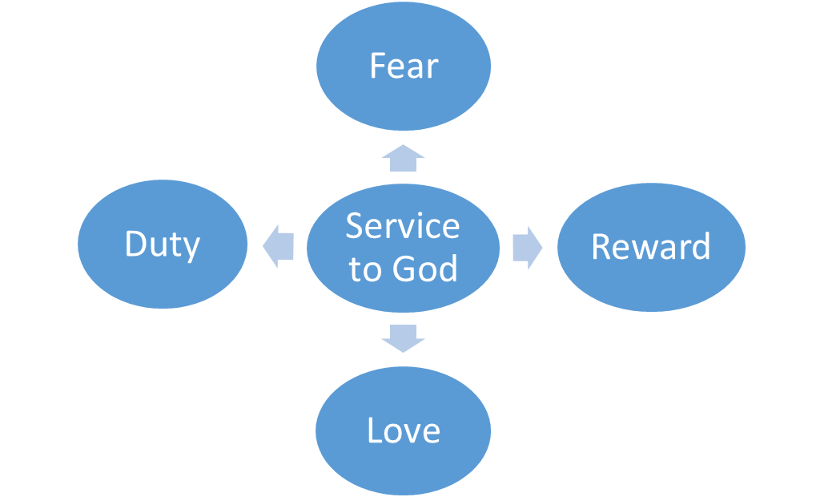
Our reasons for Serving God
Who is at the center of our lives?

Slide 4
Godly Fear
Defined as “to reverence, venerate, to treat with… reverential obedience” (Thayer)
Our service to God must begin by recognizing who He is… that is, the Creator of all things and the giver and sustainer of life. (Psalms 100:1-3; 95:1-8; 119:73; Exodus 20:20; Hebrews 12:28-29)
An inseparable link between godly fear and obedience. (Ecclesiastes 12:13-14)
Includes reverence for His will. (Psalms 4:4; Malachi 2:5)
Shown by putting Him first & abounding in his work. (Haggai 1:12; 1 Corinthians 15:58)
Key to our “persuasion” (2 Corinthians 5:11) as well as our continued pursuit of holiness. (2 Corinthians 7:1)
Notes:
We must never lose our awesome fear of God! ()

Slide 5
Love
Agape love is an act of the will and not of the heart that seeks the best interest.
Defined by God toward us and to reciprocated to Him in like kind.(1 John 4:7-21)
To be extended to all others including brethren (John 13:34; John 15:12; 1 Thessalonians 4:9-10); the lost (John 3:16) and even our enemies (Matthew 5:44)
Without it, my service will “profit me nothing”. (1 Corinthians 13:1-3)
“Perfect love casts out fear” as the primary driver of our service to God. (1 John 4:18)

Slide 6
Duty
Defined as “to owe… (be) under obligation” (Strong)
Based on our fear, it’s our duty to serve God. (Luke 17:10)
It’s our reasonable or rational service! (Romans 12:1-2)
Often translated “ought”… (Hebrews 5:12; 1 John 4:11; John 13:14) because of what He has done for us.
Not “I have to…” but eager and unashamed. (Romans 1:14-16)
“Make Me A Servant” - (Luke 15:19; 2 Timothy 2:21)
What we are to “render to God”. (Matthew 22:21)
When and with what? (Matthew 6:33; Haggai 1:4-7; Malachi 1:8; 3:10; 2 Corinthians 8:5)
Notes:
“Render” is defined as “to relinquish what is our own” and includes the idea of “requiting”

Slide 7
reward
When are we seeking our reward? (Matthew 6:1; Hebrews 11:13-16, 26)
“What then will there by for us?” (Matthew 19:27; Psalms 19:11; Psalms 58:11
“Looked to” by those who walk by faith. (Hebrews 11:10, 13-16)
With the “eyes of your heart” (Ephesians 1:18-20) looking not at the seen but the unseen. (2 Corinthians 4:16-18)
Looking forward with anticipation and longing - not fear and trepidation. (1 John 2:28; 2 Peter 3:10-15)
Preparations to be made (Matthew 25:1-13)… Endurance to be exercised. (Hebrews 10:32-39; Luke 21:19)

Slide 8
Will You Choose to Serve The Lord Today?
Out of reverence and respect for who He is (our Creator and Redeemer) and understanding of who we are (sinners who wish to be reconciled)?
Out of love for what He has done for us?
Out of duty because He deserves our faithful obedience?
Because you believe in His promises and you earnestly seek the eternal reward?

