Slide 1
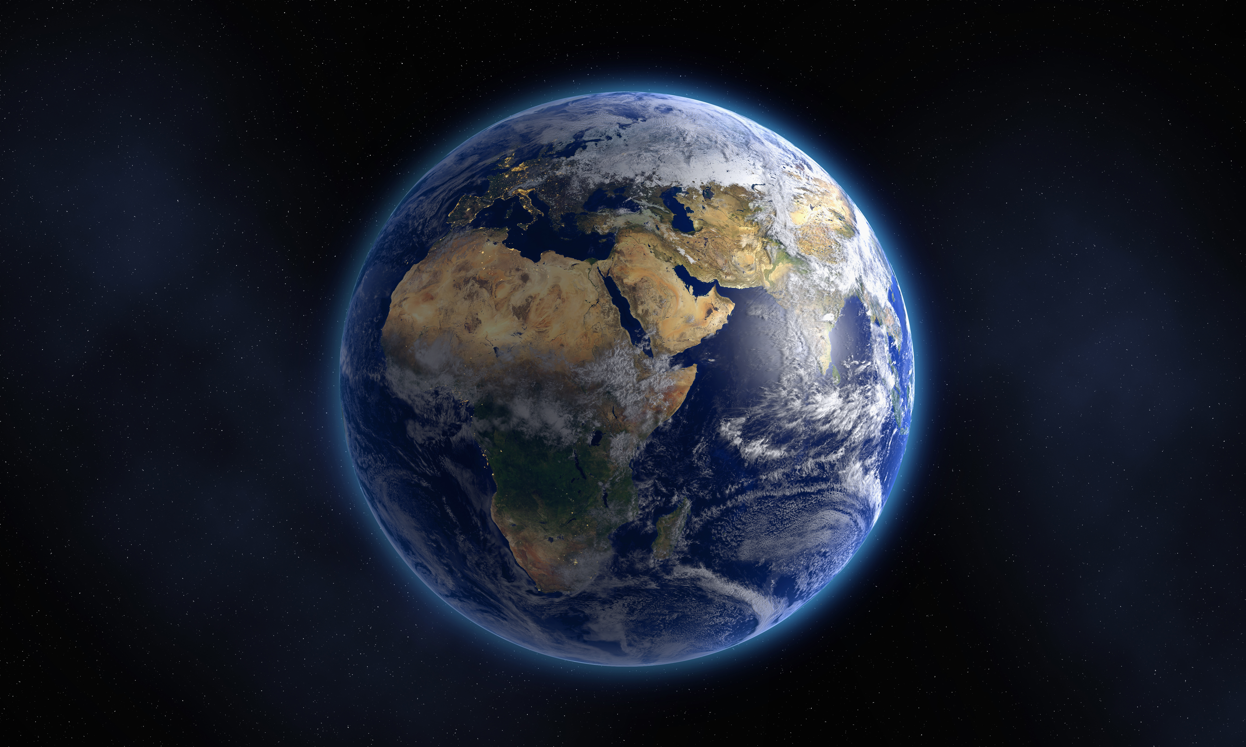
Satan’s War With the saints
Revelation Chapter 12

Slide 2
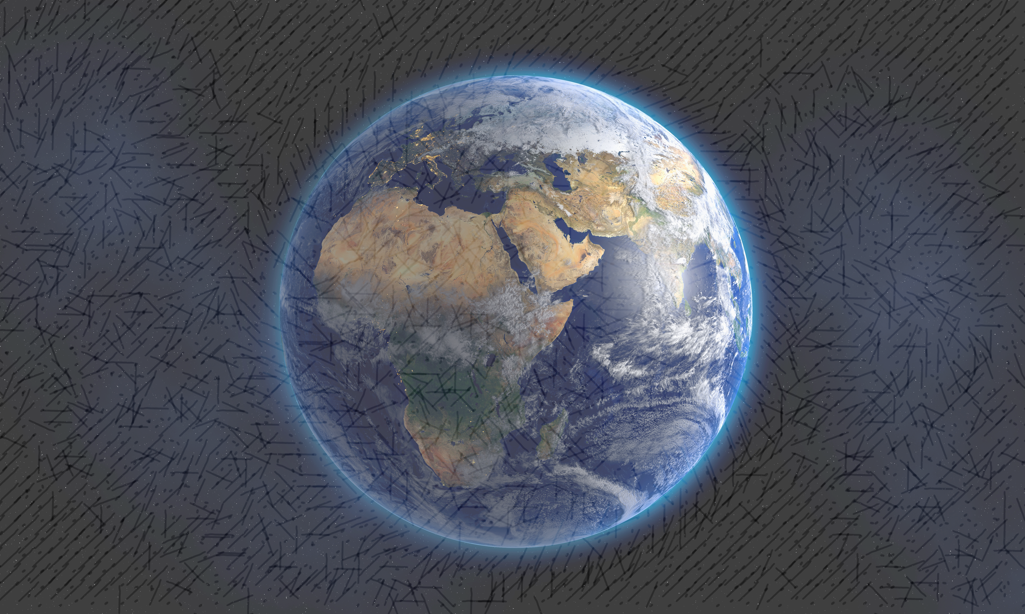
The History of the War with Satan
Began when angels “abandoned their proper abode”. (Jude 6; note Colossians 1:15-16; 1 Timothy 4:4; Psalms 5:4)
Introduced to Satan in Genesis 3 when he tempted and led Adam & Eve to sin.
God cursed Satan promising to defeat him. (Genesis 3:14-15)
Satan’s persistent attempts to defeat God’s plan, purpose & promises. (Exodus 1-2; Numbers 13-14; 22-24; 2 Kings 11; Esther; Isaiah 1:9)
Notes:
Col 1:15-17
1 He is the image of the invisible God, the firstborn of all creation. 16 For by Him all things were created, both in the heavens and on earth, visible and invisible, whether thrones or dominions or rulers or authorities — all things have been created through Him and for Him. 17 He is before all things, and in Him all things hold together.
1 Tim 4:4
For everything created by God is good…
Ps 5:4
4 For You are not a God who takes pleasure in wickedness; No evil dwells with You.
Ps 92:15
To declare that the Lord is upright; He is my rock, and there is no unrighteousness in Him.
Exodus 1:16 - Pharoah orders to put the Hebrew male children to death. Chapter 2 God ensures His promises will go forth.
Numbers 13-14 - except for the remnant of Joshua and Caleb, God’s promises would be defeated.
Numbers 22-24 - efforts to destroy God’s people through curses by Balaam but Satan is again thwarted.
2 Kings 11 - after the promise to David that one of his descendants would sit on his throne forever, Satan tries to destroy his lineage by Athaliah putting to death all “the royal offspring” (11:1) of King Ahaziah of Judah but again he is defeated by his sister who rescued Joash, the last son to preserve the lineage.
Esther - chapter 4 and the plot to kill and anhilate all the Jews as they were perceived to be a threat. Note Esther 3:8, “Then Haman said to King Ahasuerus, "There is a certain people scattered and dispersed among the peoples in all the provinces of your kingdom; their laws are different from those of all other people and they do not observe the king's laws, so it is not in the king's interest to let them remain.
Note chapter 4 and that God used Esther to ensure that His people would not be destroyed (and thus the promise of redemption). But also note that as Mordecai noted to Esther, she had a choice to make and that if she didn’t intercede to save God’s people, he had faith that God would defeat this plot through someone else. Esther 4:13-14
Then Mordecai told them to reply to Esther, "Do not imagine that you in the king's palace can escape any more than all the Jews. 14 "For if you remain silent at this time, relief and deliverance will arise for the Jews from another place and you and your father's house will perish. And who knows whether you have not attained royalty for such a time as this?"
Isa 1:9
Unless the Lord of hosts Had left us a few survivors, We would be like Sodom, We would be like Gomorrah.

Slide 3
The War with Satan
Revelation Chapter 12 speaks of this war!
It speaks of a “war in heaven”, of Satan’s efforts to thwart the plans, promises and purposes of God. (vs. 7)
It also speaks of a “war with the rest of her children” to overcome those who are the faithful and obedient. (vs. 17)
Notes:
Emphasize again that this war, though real, is being described with signs. The description is not to be taken literally in terms of literal dragons, etc.

Slide 4
Revelation Chapter 12, Who Is signified by…?
The woman - God’s spiritual remnant. (Micah 4:6-12; 5:1-6; Isaiah 66:5-10; cf., Revelation 12:17, all who “keep the commandments of God and hold to the testimony of Jesus.”
“Clothes with the sun…” bears the light of holiness and wears the crown of victory.
“With child…”; the promise of hope and redemption. (Matthew 11:3; Luke 2:25, 36; Hab. 2:3)
Notes:
The “woman” - the remnant of spiritual Israel that remained faithful to God until the Messiah came. (Think Simeon and Anna in Luke 2) After Jesus came (after the woman gave birth to the child), the remnant of God’s faithful in the church. Whoever was faithful to the covenant with God they lived under.
Mic 4:6-12
In that day," declares the Lord, "I will assemble the lame And gather the outcasts, Even those whom I have afflicted.
7 "I will make the lame a remnant And the outcasts a strong nation, And the Lord will reign over them in Mount Zion From now on and forever. 8 "As for you, tower of the flock, Hill of the daughter of Zion, To you it will come —Even the former dominion will come, The kingdom of the daughter of Jerusalem.
9 "Now, why do you cry out loudly? Is there no king among you, Or has your counselor perished, That agony has gripped you like a woman in childbirth? 10 "Writhe and labor to give birth, Daughter of Zion, Like a woman in childbirth; For now you will go out of the city, Dwell in the field, And go to Babylon. There you will be rescued;There the Lord will redeem you From the hand of your enemies. 11 "And now many nations have been assembled against you Who say, 'Let her be polluted, And let our eyes gloat over Zion.' 12 "But they do not know the thoughts of the Lord, And they do not understand His purpose; For He has gathered them like sheaves to the threshing floor.
Mic 5:2-4
1 But as for you, Bethlehem Ephrathah, Too little to be among the clans of Judah, From you One will go forth for Me to be ruler in Israel. His goings forth are from long ago,
From the days of eternity."
3 Therefore He will give them up until the time When she who is in labor has borne a child. Then the remainder of His brethren Will return to the sons of Israel.
4 And He will arise and shepherd His flock In the strength of the Lord, In the majesty of the name of the Lord His God.
Isa 66:5-10
Hear the word of the Lord, you who tremble at His word:“ Your brothers who hate you, who exclude you for My name's sake, Have said, 'Let the Lord be glorified, that we may see your joy.’ But they will be put to shame.
6 "A voice of uproar from the city, a voice from the temple, The voice of the Lord who is rendering recompense to His enemies.
7 "Before she travailed, she brought forth; Before her pain came, she gave birth to a boy. 8 "Who has heard such a thing? Who has seen such things? Can a land be born in one day? Can a nation be brought forth all at once? As soon as Zion travailed, she also brought forth her sons. 9 "Shall I bring to the point of birth and not give delivery?" says the Lord. "Or shall I who gives delivery shut the womb?" says your God.
Joy in Jerusalem's Future
10 "Be joyful with Jerusalem and rejoice for her, all you who love her; Be exceedingly glad with her, all you who mourn over her,
Matthew 11:3 - John asked if Jesus was “the Expected One”
Luke 2:25, 36 - Simeon and Anna
Hab 2:3
For the vision is yet for the appointed time; It hastens toward the goal and it will not fail.
Though it tarries, wait for it; For it will certainly come, it will not delay.

Slide 5
Revelation Chapter 12, Who Is signified by…?
The great red dragon (vs. 4) - identified as “the devil and Satan” (vs. 9) who is “a murderer from the beginning” (John 8:44)
“Swept away a third of the stars of heaven” (2 Peter 2:4; Jude 6)
“Stood before the woman… so that when she gave birth he might devour the child.” (Matthew 2:16; cf., Exodus 1:15-16)
Notes:
The “woman” - the remnant of spiritual Israel that remained faithful to God until the Messiah came. (Think Simeon and Anna in Luke 2) After Jesus came (after the woman gave birth to the child), the remnant of God’s faithful in the church. Whoever was faithful to the covenant with God they lived under.
The dragon - 7 heads signify the fulness of his earthly intelligence and wisdom. Mastermind of all deceit and craftiness. 10 horns signify the power of his realm upon earth. Picture of “complete diabolical power, wisdom and cunning against which the church and it’s saints must fight for survival. Seven diadems - the adornment of royalty. Not a victory crown. Metaphor for royal power and rule. Limited by God to the fleshly realm and ultimately subject to Jesus.
Note in vs. 4 his power and destruction: his tail swept away 1/3 of the stars of heaven. Able to lead even the hosts of heaven astray in defiance. 2 Peter 2:24; Jude 6. Should not we be warned!

Slide 6
Who Is signified by…?
The child she gave birth to, “a son”.
The Messiah - Prophet, Priest & King
Who would “rule all the nations” (Psalms 2; 45:6; 110:5-7)
Who would be “caught up to God and to His throne” (3:21), victorious and with “all authority”. (Matthew 28:18; Ephesians 1:20-23)
The “rest of her offspring” (vs. 17; cf., Romans 8:29) are those are faithful and “keep the commandments of God”.
Notes:
Not to focus on just His birth but His entire life until He ascended to His Father.
Jesus’ death perhaps seemed as if Satan had won but they later understood when He was raised from the dead, and then ascended to the Father, that He had crushed Satan’s head. Daniel 7:13-14
Ps 45:3-4
Gird Your sword on Your thigh, O Mighty One, In Your splendor and Your majesty!
4 And in Your majesty ride on victoriously, For the cause of truth and meekness and righteousness; Let Your right hand teach You awesome things.
5 Your arrows are sharp; The peoples fall under You; Your arrows are in the heart of the King's enemies.
6 Your throne, O God, is forever and ever; A scepter of uprightness is the scepter of Your kingdom.
Ps 110:5-7
The Lord is at Your right hand; He will shatter kings in the day of His wrath.
6 He will judge among the nations, He will fill them with corpses, He will shatter the chief men over a broad country.
7 He will drink from the brook by the wayside; Therefore He will lift up His head.
Rev. 3:21 - the Lord invites us to sit with Him on His throne.
Rev. 5:7 -

Slide 7
“There was War in heaven” (vs. 7)
Chapter 12:1-8
A war begun in the beginning. (Genesis 2; 3:15)
The efforts to thwart God’s plans & purposes throughout the OT through idolatry, moral impurity, discouragement and prosperity.
God would protect His remnant from extinction during this period of great tribulation as God provided refuge. (12:6; Hebrews 6:18)
Notes:
Fighting against Satan and his servants:
Idolatry - Balaam
Moral impurity - Balaam
Discouragement - The ten spies Numbers 14
Prosperity -
She “fled into the wilderness” or a place of refuge uninhabited by enemies for a limited period of time. (3 ½)
Primary audience are those to whom John is writing who are facing the tremendous suffering inflicted on them. We also must seek “refuge” in Him and His word. (Hebrews 6:18)
Did Rome have the military tools to squash out Christianity? Yes, but God would not permit it.
Heb 6:17-20
In the same way God, desiring even more to show to the heirs of the promise the unchangeableness of His purpose, interposed with an oath, 18 so that by two unchangeable things in which it is impossible for God to lie, we who have taken refuge would have strong encouragement to take hold of the hope set before us. 19 This hope we have as an anchor of the soul, a hope both sure and steadfast and one which enters within the veil, 20 where Jesus has entered as a forerunner for us, having become a high priest forever according to the order of Melchizedek.
Christ typified by the cities of refuge: --
I. EVERY SINNER IS JUSTLY EXPOSED TO DEATH. Pursued by the righteous avenger of blood, who will cast the wicked into hell, with all the nations that forget God.
II. GOD HATH APPOINTED JESUS AS THE REFUGE FOR CONDEMNED SINNERS. He came that men might not perish, but have everlasting life. He came not to destroy men's lives, but to save them. Now in this He was strikingly typified by the cities of refuge.
(The Biblical Illustrator Copyright.)

Slide 8
War On Earth with The Saints
Chapter 12:9-17
“The great dragon was thrown down… and his angels with him.” (vs. 9)
“The accuser of our brethren… they overcame him…” (vs. 10)
“The dragon was enraged with the woman, and went off to make war with the rest of her children.” (vs. 17)
“It was given to him to make war with the saints and to overcome them…” (13:7)

Slide 9
What has “Come” to us?
Chapter 12:10
“Salvation” -. (Luke 1:77; 1 Peter 1:5-12; 2 Peter 3:15; 1 Thessalonians 5:8; Hebrews 2:3)
“Power” - (Romans 1:16; Philippians 3:9-10; Colossians 1:10-12)
“The Kingdom” - (Colossians 1:13; Hebrews 12:28)
“Authority of His Christ” - (Hebrews 1:1-2; Colossians 2:9-10, 15)

Slide 10
How To Overcome
Chapter 12:11 - “They overcame him...”
“Because of the blood of the Lamb” - by God’s grace and the sacrifice of Jesus Christ. (1 Peter 1:18-23; Ephesians 2:8-10; Romans 6:3-4; Hebrews 10:19ff)

Slide 11
How To Overcome
Chapter 12:11 - “They overcame him...”
“Because of the word of their testimony” - those who testified of their faith in Jesus Christ and in Him only.
“Testimony” - lit. “evidence given” (Strong) Persuasion through the gospel. (Acts 22:18)
Romans 1:14-16, indebted, eager and not ashamed.

Slide 12
How To Overcome
Chapter 12:11 - “They overcame him...”
“Because they did not love their life even to death” - those “faithful unto death” (2:10).
What can Satan do with one who has the mindset of Paul, “For to me, to live is Christ, and to die is gain.” (Philippians 1:21; Hebrews 11:32ff; 1 Peter 1:6-9; )
Notes:
Polycarp Refuses to Deny Jesus
As Polycarp was being taken into the arena, a voice came to him from heaven: “Be strong, Polycarp and play the man!” No one saw who had spoken, but our brothers who were there heard the voice. When the crowd heard that Polycarp had been captured, there was an uproar. The Proconsul asked him whether he was Polycarp. On hearing that he was, he tried to persuade him to apostatize, saying, “Have respect for your old age, swear by the fortune of Caesar. Repent, and say, ‘Down with the Atheists!’” Polycarp looked grimly at the wicked heathen multitude in the stadium, and gesturing towards them, he said, “Down with the Atheists!” “Swear,” urged the Proconsul, “reproach Christ, and I will set you free.” “86 years have I have served him,” Polycarp declared, “and he has done me no wrong. How can I blaspheme my King and my Savior?”
11. More Attempts to Make Him Submit
“I have wild animals here,” the Proconsul said. “I will throw you to them if you do not repent.” “Call them,” Polycarp replied. “It is unthinkable for me to repent from what is good to turn to what is evil. I will be glad though to be changed from evil to righteousness.” “If you despise the animals, I will have you burned.” “You threaten me with fire which burns for an hour, and is then extinguished, but you know nothing of the fire of the coming judgment and eternal punishment, reserved for the ungodly. Why are you waiting? Bring on whatever you want.”

Slide 13
He Who Overcomes
We also must “fight the good fight of faith” as faithful soldiers. (1 Timothy 6:12; 2 Timothy 2:2-4)
“He who overcomes will inherit these things, and I will be his God and he will be My son.” (Revelation 21:7)
“Blessed are those who wash their robes, so that they may have the right to the tree of life, and may enter by the gates into the city.” (Revelation 22:14)

