Slide 1
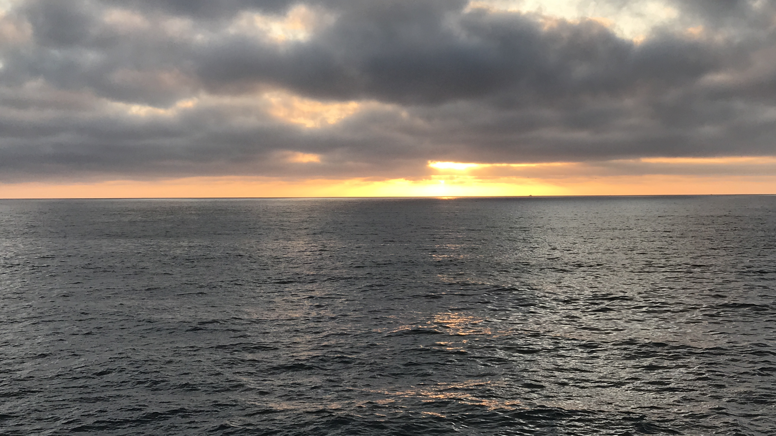
Being Healed Of Leprosy
Luke 17:11-19

Slide 2
Jesus, Master, Have mercy on us
Come to Me all who are weary and heavy laden… Matthew 11:28-30
Ten lepers raise their voices and seek “mercy” from Jesus. (vs. 13)
Jesus tells them, “Go and show yourselves to the priests” (vs. 14)
They went, and “as they were going, they were cleansed.” (vs. 14)
One “turned back” and was “glorifying God with a loud voice” and returned to Jesus and “fell on his face at His feet, giving thanks to Him.” (vs. 15-16)
Jesus said, “Were there not ten cleansed, but the nine - where are they?” (vs. 17)

Slide 3
Understanding Leprosy
A deadly, horrific and uncurable disease.
“The scourge of the ancient world.”
“Spongy, tumor-like swellings grow on the face and body. The disease becomes systemic and involves the internal organs as well as the skin. Marked deformity of the hands and feet occur when the tissues between the bones deteriorate and disappear… Untreated cases may be sick with lepromatous leprosy from ten to twenty years, death occurring from the disease itself…”
(The Zondervan Pictorial Encyclopedia of the Bible, "Leprosy.")
Notes:
Leprosy is a chronic, infectious disease characterized by sores, scabs, and white shining spots beneath the skin.
(from Nelson's Illustrated Bible Dictionary)
Leprosy was the scourge of the ancient world. Nothing evoked more fear, more dread, or more revulsion than the sight of these walking dead. That is what a leper was called, a walking dead man. The smell of his decaying flesh would announce his coming long before the tattered scraps of his clothing would be seen, or his raspy "Unclean! Unclean!" announcement he was required to declare, could be heard. The stumbling shuffle of toeless feet, the wandering of sightless eyes and the moan of a cheek less mouth, all pointed to Leprosy, this unseen attacker that slowly destroyed human bodies, and made the individual an untouchable to society.
The great Jewish culture scholar, Edersheim, says the disease which we today call leprosy generally begins with pain in certain areas of the body. Numbness follows. Soon the skin in such spots loses its original color. It gets to be thick, glossy, and scaly. ... As the sickness progresses, the thickened spots become dirty sores and ulcers due to poor blood supply. The skin, especially around the eyes and ears, begins to bunch, with deep furrows between the swellings, so that the face of the afflicted individual begins to resemble that of a lion. Fingers drop off or are absorbed; toes are affected similarly. His throat becomes hoarse, and you can now not only see, feel, and smell the leper, but you can hear his rasping voice. And if you stay with him for some time, you can even imagine a peculiar taste in your mouth, probably due to the odor.

Slide 4
Understanding Leprosy
Leviticus chapter 13
Uncurable by natural means during biblical times.
(2 Kings 5:7)
Required complete separation/isolation from all others and all clothing to be burned as any contact with a leper would contaminate. (13:45-46)
Required the leper to “cry, ‘Unclean! Unclean!” (13:45-46)
Anything contaminated to be destroyed. (13:55)
Notes:
Leprosy is a chronic, infectious disease characterized by sores, scabs, and white shining spots beneath the skin.
(from Nelson's Illustrated Bible Dictionary)

Slide 5
A “type” of sin
Contagious (1 Corinthians 5)
Progressive (2 Timothy 3)
Incurable by man alone (2 Kings 5:7)
Shameful and disgraceful (Jeremiah 8:12)
Brings separation (Isaiah 59:1-2)
Brings death (Romans 6:23; James 1:15)
Notes:
Leprosy is a chronic, infectious disease characterized by sores, scabs, and white shining spots beneath the skin.
(from Nelson's Illustrated Bible Dictionary)

Slide 6
Old testament examples
Naaman (2 Kings 5)
Example of faithful obedience necessary. (vs. 10-14)
“Behold I thought…” (vs. 11)
Any leper would be willing to do any “great thing” to be free of this horrible disease. (vs. 13)
“Wash and be clean” (vs. 13; cf., Acts 22:16)
By God’s grace and our faith. (Luke 4:27; John 9)
Once cleansed, will we go back? (2 Corinthians 6:14ff)
Brought about by sin. (vs. 27)
Notes:
Leprosy is a chronic, infectious disease characterized by sores, scabs, and white shining spots beneath the skin.
(from Nelson's Illustrated Bible Dictionary)

Slide 7
Old testament examples
King Uzziah (2 Chronicles 26)
Someone determined to “seek God”. (vs. 5)
God helped him (vs. 7) & “his fame spread afar…” (vs. 15)
His heart became “so proud” and “acted corruptly” as he thought he could take on priestly duties. (vs. 16-18)
God struck him with leprosy (vs. 19-21) and he was “cut off from the house of the Lord” until the day he died.
He was separated from God because of his sin!
(Isaiah 59:1-2)
Notes:
Leprosy is a chronic, infectious disease characterized by sores, scabs, and white shining spots beneath the skin.
(from Nelson's Illustrated Bible Dictionary)

Slide 8
Old testament examples
4 lepers (2 Kings 7)
Also separated because of their leprosy. (vs. 3)
All were dying because of the famine (6:24-25)
These lepers reason that they will seek compassion from the Arameans. (vs. 4)
God had caused the Arameans to flee & leave everything (vs. 6-7), the lepers discover provisions in abundance. (vs. 8)
They realize they must share the good news. (vs. 9)
We must share the good news!
Notes:
2 Kings 7:9-11
The four leprous men exemplify our condition. Like them we were (lost) cast out of the congregation of the saints; like them we were loathsome in our own eyes: like them, we were infectious to our neighbors: like them, we were under the ban and curse of God; but, like these leprous men, He filled us with views of our own misery, made us discontented with the state in which we were, raised a spark of hope in our bosoms, that for us there might be hope, and that we might, as we could not be in a worse condition, be better, by application to His mercy and grace. But there is another point connected with the day in which we live -- that Jesus Christ has opened channels for the publication of these good tidings to others. This day may be emphatically called, indeed, "a day of good tidings."
(The Biblical Illustrator.)

Slide 9
New testament examples
Mark 1:40-45, a leper said to Jesus, “If You are willing, You can make me clean.” Jesus replied with compassion, “I am willing; be cleansed.”
Immediately he was cleansed and Jesus warned him not to tell anyone but to “show yourself to the priests”.
“But he went out and began to proclaim it freely and to spread the news about…” (cf., Mark 5:19-20)

Slide 10
Back to the ten Lepers
All ten were healed because of their faith.
Leviticus 14 required anyone who was clean to present themselves to the priests.
Going by these ten meant they trusted Jesus that He would cleanse them.
But they had to go…

Slide 11
Back to the ten Lepers
What would each do with their “newness of life”? (Romans 6:3-4) What will we do?
Something worse could befall them! (John 5:14) It can happen to us also? (2 Peter 2:20)
Would they (continue to) worship God? Will we offer our lives as living sacrifices? (Romans 12:1-2)
Will we freely share how others can be cured of such a horrible disease?

