Slide 1
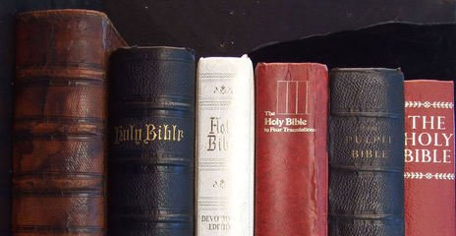
Preventing Apostasy -
Fear & Trembling
2 Peter Chapter 2 & Jeremiah

Slide 2
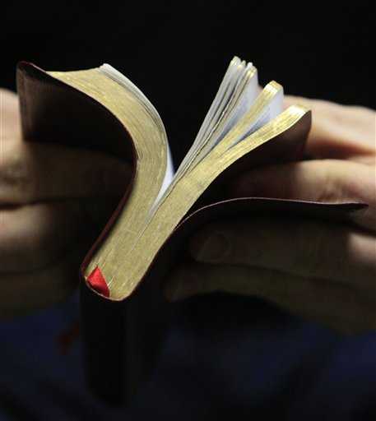
Why did Israel turn away in continual apostasy? (Jeremiah 8:4-5)
Peter warns of those who would lead Christians into apostasy in 2 Peter 2. There always have been & always will be as long as our adversary fights us!
Jeremiah Chapter 8:4-5; cf., 2 Thessalonians 2:3
What is apostasy?
Hebrew word means “a turning away, a turning back… a backsliding” (Thayer) through action or inaction.
Greek word “apostasia” meaning “defection from truth” (Strong), “a falling away”. “A defection or revolt”. (Vine)
Notes:
Apostasy - (9 of 12 times used by Jeremiah)
In the NT, in 2 Thessalonians 2:3 Paul references an “apostasy” that would come before the Lord returns.

Slide 3
Apostasy Can Be Averted!
We don’t have to just sit and watch it happen!
That’s why Paul warned the Ephesian elders in Acts 20:29-30 and later wrote the Epistle to them (Ephesians 4:14; 6:10ff)
That’s why Paul spent so much time warning Timothy & Titus! (1 Timothy 1:3; 6:3, 20-21;
2 Timothy 2:15-18; 4:2-4; Titus 2:1)
The book of Hebrews is in many ways a letter about preventing apostasy.
(Hebrews 2:1; 3:12-15; 6:1-6)
Notes:
Apostasy - (9 of 12 times used by Jeremiah)
In the NT, in 2 Thessalonians 2:3 Paul references an “apostasy” that would come before the Lord returns.

Slide 4
Learning from Peter the need for fear & Trembling
2 Peter Ch. 2 - ways to prevent apostasy.
2 Peter 2:10-11, “Daring, self-willed, they do not tremble when they revile angelic majesties…”
Godly fear & trembling will help prevent apostasy! Without, it is unrestrained.
(Psalms 36:1-4; Romans 1:18ff; 3:10-18)
Notes:
2nd Peter 2:22… “it has happened.” Some have “turned away” vs. 21

Slide 5
It is the “whole duty of Man”
Ecclesiastes 12:13-14
(Ecclesiastes 3:14; 8:11-12)
Begins with believing “He is…” and “a rewarder” (Hebrews 11:6)
It’s at the very core of what God seeks from man. (Deuteronomy 10:12-14)
We cannot separate fear & reverence for God from fear & reverence for His word. (Isaiah 66:1-2)
Notes:
. Just to be afraid of God or his word is not enough. To tremble at God’s word is to be so affected by it as to be brought to repentance.

Slide 6
What does it mean to Tremble at His word?
Jeremiah prophesied during the reign of King Josiah and spoke of their lack of reverence for God’s word. (Jeremiah 2:19; 5:24; 36:23-24)
Note what Kings were supposed to do! (Deuteronomy 17:18-19; 31:10-13; 6:1-9)
Josiah’s reign began with the “book” of the Law lost out of sheer neglect. (2 Kings 22:8)
Josiah had the book read to him and he “tore his clothes” (trembled). (vs. 11)

Slide 7
Mere “trembling” Is Not Enough…
Mere “trembling” is not enough!
(James 2:19-20; Acts 24:25 KJV)
We must be persuaded to act!
(2 Corinthians 5:10; cf., Psalms 4:4; 96:9)
As in the beginning. (Acts 2:43; 5:11; 9:31; 16:29)
Have we lost our sense of reverence for His word? (1 Peter 2:2; Matthew 5:6; 2 Tim. 2:15; Nehemiah 8:1-8; Malachi 2:1-5)
Notes:
The word used to describe Felix’s reaction to what was preached is a word that comes from a word which means “fear.” For this reason, Arndt and Gingrich define the word as meaning “afraid, startled, terrified”
And fear came upon every soul: and many wonders and signs were done through the apostles. This fear was not that which partakes of aversion; for we learn below (47) that many were daily added to the church. It was that solemn awe which miracles naturally inspire, mingled with profound reverence for a community universally characterized by holy living.”
Ωε κνοω τηε ωορδ οφ Γοδ ισ βεινγ τραμπλεδ υπον ιν τηε ωορλδ βεινγ χαλλεδ ιναχχυρατε, ουτδατεδ, υντρυστωορτηψ. THERE is another group that we need to consider … They believe the Bible to be verbally inspired of God (2 Tim. 3:16, 17), & contextually accurate in its message. BUT, when it comes to studying and living its message, they fall way short. They see the Bible as the word of God, but they are not moved by its message to the point of total obedience and submission. In other words, they know that they have the word of God preserved in written form (or revealed orally), but they choose to flippantly dismiss it or apply it randomly when it agrees with their personal desires. Or they become so familiar with it that it is no longer treated with the reverence that the Word of God deserves. In this category you will find those who see no need to intensely study the word of God (2 Tim. 2:15) and therefore are ignorant to its message and/or living lives of nominal service to God. Jesus described them as “thorny ground” (Luke 8:14).
Story of woman sweeping the floor and her son sees her bend over and pick up a small piece of paper instead of sweeping it up with the rest and asks why? It was a corner of one of the pages of her bible that had torn off and she would not sweep it up with the rest of the trash.

Slide 8
Mere “trembling” Is Not Enough…
Stop looking for exceptions as to why it doesn’t apply. (Mark 7:9; James 1:19-21)
Not just approach academically but making application... Becoming an “effectual doer”. (James 1:22-25)
Respect its’ power, purity and silence!
(Romans 1:16, Acts 15:24; Galatians 1:6-9)

Slide 9
What does it mean to Tremble at His word?
Appreciate and defend its’ accuracy and completeness. (Jude 3; Galatians 1:6-9)
Commitment to persistently and lovingly preach and teach all of it! (2 Timothy 4:1-3; Acts 20:27; Jeremiah 20:7-9; 26:2; 36:23-32)
Regardless of the results. (2 Peter 2:5;
2 Kings 23

Slide 10
What does it mean to Tremble at His word?
Be impressed! Have faith! (1 Cor. 2:10-13; Deuteronomy 29:29; 2 Timothy 3:16-17)
Don’t take for granted! (Amos 8:12)
Seek His word diligently with a tender heart! (2 Kings 22:19; 1Chronicles 28:9)
Make the effort… spend the time… avoid minimums… eat it up! (2 Timothy 2:15; Ephesians 5:15-17; Colossians 3:16; Luke 10:41-42)
Notes:
Be Impressed that God chose to communicate with you!
Satan is continually seeking to take it away! Value the price that others have paid to make it accessible.
William Tyndale died so that we might have the bible accessible. 75% - 90% of the KJV was based on his work. 1526 first copy of entire NT. 1529 the penteteuch which was lost in a shipwreck. Finished in 1530. Revised in 1534. by 1535 books of OT history.
Authorities finally caught up with him in 1535 in Belgium and died a year and a half later affixed to a stake, strangled and then burned.
Myles Coverdale also devoted his life to making the bible accessible. 1488-1569

Slide 11

Future Lessons From
2nd Peter 2 regarding preventing apostasy
Consequences
Be bold & w/o hypocrisy
Be spiritually minded
Contentment
Trusting God’s judgment
Respect God’s authority
Humility and submission
Reason & persuasion
Knowledge

